Slide 1
Invoicing:
EDI versus AI
(Part One)
Testing and evaluating new features
By: Sharon Whittle and Matt Thomas, Wilfrid Laurier U

Slide 2
Introductions
Information Resources (IR) Team @ Laurier
Ania Szablewski, IR Associate
Caroline Houle, IR Associate
Christina Kerr, IR Associate
Doug Roberts IR Associate
Sharon Whittle, Manager IR
Matt Thomas, Head IR

Slide 3
Invoicing: Electronic Data Interchange (EDI) versus Artificial Intelligence (AI)
Following Laurier’s responsible use and safe practices policies for AI testing and or adoption
Compile the needed documentation and provide to the appropriate parties for review
Obtain any necessary documentation from the vendor on the feature
Determine the level of access to secure information as per our organization’s Information Governance Policy
Submit PSAI (privacy and security impact assessment )

Slide 4
Considerations
This feature will, when released, be available to enable in your Alma instance; however, it may require vetting through ICT and legal departments prior to enabling
Gen AI tools can pose security and privacy risks
Our policy is that confidential, internal or restricted information must not be uploaded into public AI tools
Following the privacy and security impact assessment ICT and legal will approve or deny the feature for testing

Slide 5
Invoicing: Electronic Data Interchange (EDI) versus Artificial Intelligence (AI) evaluation
Defining the areas of evaluation
Understanding the criteria and parameters by which we measure AI workflows in this and future release features.
Why are we interested in using the feature?
What are the benefits versus the risks of using the feature?
And can we develop a matrix to assist with rationale to AI adoption?

Slide 6
Defining Areas of Evaluation
Reviewing the new AI features in Alma Acquisitions:
Need for services
Compare to existing capabilities
Functionality versus hype
Costs and impacts
Efficiencies versus efficiencies

Slide 7
Need for Services
First area of evaluation

Slide 8
Need for Services
  What are the invoice types that might benefit with an alternative
    EDI or Manually created are the two formats currently used
  What we are not considering in this investigation
    Invoices NOT transferred to Accounts Payable for upload into Enterprise Resource Planning Software (ERP) such as Purchase Cards; Deposit Ledgers (OCUL); and internal transfers will not be included in the review
  What is the potential volume of invoices where this process would be useful
    Number of invoices
    Length of invoice (number of invoice lines)
    Number of vendors

Slide 9
Number of invoices created via EDI versus Manually

Slide 10
Vendor to invoice volume EDI and Manual
Total number of active vendors in 2025 = 115
Total number of invoices in 2025 = 1186
Vendors without EDI = 111
Vendors with EDI = 4
Invoice volume from vendor | Without EDI | Number of invoices 2025
Zero invoices | 50 | 0
More than 1 less than 5 | 56 | 152
More than 5 less than 10 | 2 | 17
More than 10 less than 100 | 3 | 66
Invoice volume from vendor | With EDI | Number of invoices 2025
Zero invoices | 0 | 0
More than 1 less than 10 | 2 | 6
More than 10 | 1 | 71
More than 100 | 1 | 874

Slide 11
Comparing existing features
Second area of evaluation

Slide 12
Existing Capabilities
  EDI
  Excel
  Manual
  XML
  NOTE – all methods (except manual) convert to XML and translate the information to the fields on the invoice in Summary tabs and Invoice Line tabs therefore reviewing how the XML works is unnecessary
  NOTE – Excel will not be used in trial runs

Slide 13
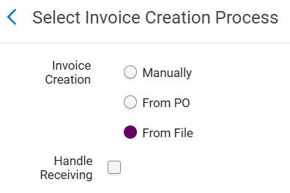
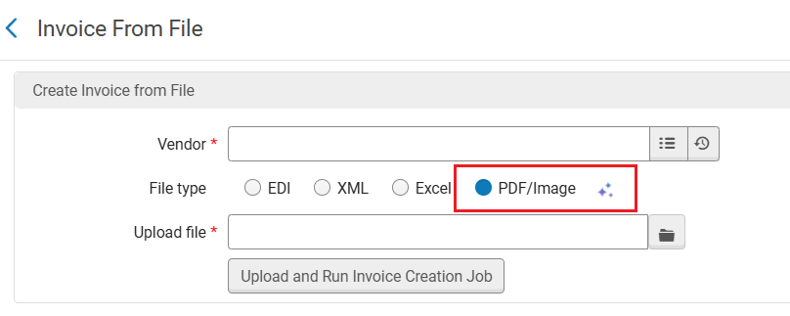
Methods
Existing methods:
Automatically using EDI
Manually, by uploading Excel or specific XML formats
Manually, by typing the information
New method:
Upload the PDF/Image of the invoice, as retrieved from the vendor
Up to 20 PDF pages!
Alma will generate the invoice with its lines
The invoice will be created with “In Review” status

Slide 14
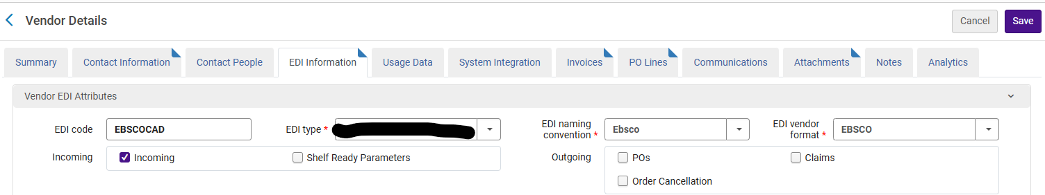
EDI set up with Vendors – EBSCO example
Need a match point (the POL is preferred – but can also use the Order Number found in the Vendor Order No field)
Vendor Default EDI code
Customer’s EDI code
  Customer’s EDI Code Type
Need the following entered in Alma (EBSCO will provide most and your ICT)
  NODE NAME:
  USERID:
  PASSWORD:
  SUB-DIRECTORY:
  TRANSFER TYPE:
  Port
And provide the vendor FTP details

Slide 15
Making an invoice manually – EBSCO example
The path
  Alma > Acquisitions > Receiving & Invoicing > Create Invoice > Manually > Next
Fill fields as required
On “Summary” tab
  Fill 7 fields (Invoice number; Date; Vendor; Vendor Account; Total (XPAR); payment method; expend from fund)
Save and create invoice lines
On “Invoice line” tab
  Add invoice line > Using POL line field look up and select POL
  Enter additional information or change information
    Subscription term; different price than encumbered; split funds; release encumbered funds, etc.
  Add service fees if required
  Add tax lines (number of tax lines varies)
Add and close
Attach PDF of invoice
Ensure XPAR (expect to pay after rebate) and TILA (total invoice lines amount) match
Vet to ensure accuracy
Save and Continue to send invoice to Approval queue

Slide 16
Taxes and Rebate Entitlements – Realities of Life
Alma
Tax Handling and Entitled Rebates
Invoice Lines
Amounts Remitted to Vendors Versus Amount Deducted from Accounts
Financial System ERP - Banner
Taxes for remittance to vendors and self-assessed amounts
Entitled rebates from the gov’t or required remittances
Financial system capacity (Enterprise Resource Planning - ERP)
  We use Banner
Invoice lines and totals depending on fund
  Separating due to accrual accounting
WHERE DOES ALMA FIT IN?
WHERE DO THE VENDORS FIT IN?

Slide 17
Functionality versus hype
Third area of evaluation

Slide 18
Functionality versus Hype
  Knowing the company’s stance on AI features and their goal
    Defining their principles
    Transparency in how it works
    Transparency in partners
    Transparency in environmental cost
  Operate as Defined in Real Time
    Works as describe

Slide 19



AI at the Service of Libraries and Librarians
Be Beneficial
Transform & increase efficiencies
Responsible AI Use
Offer helpful and
ethical solutions
Unlock library workflow efficiencies with innovative technology
AI Principles Informed by the Library Community
Identify needs and pain points | Assist librarians
Respect laws and best practices | Community collaboration
Agentic AI & assistants | Metadata using LLM & image processing
Process Automation | Data Insights
Human in charge | Opt-in features
Ethical & safe: AI not trained on uploaded data, limited web access
Academic AI Platform: Powering all Clarivate Products

Slide 20





Practical & Responsible AI
AI Metadata
AI Acquisition Assistant
AI Entity Creation
Create and enhance records using the Metadata Assistant
NEW: Enrich Bibliographic Records job using AI title matching
Conversational workspace, Ask questions, take actions
Automatically create Alma administrative entities
NEW: Create an invoice from PDF/Image
AI Insights
MCP Ready
Alma LibOW AI
Actionable, data-driven recommendations that help libraries optimize workflows, collections, and decision-making
Enable MCP support in Alma to allow controlled AI agent capabilities
Extensible AI integration point that allows libraries to connect Alma workflows with external AI models and agents to automate tasks
Notes:
Our approach is to leverage AI technologies to deliver value in three key areas: driving operational efficiencies, enhancing the user experience, and generating meaningful insights to support better decision-making
Go through the different features and explain how they relate to the three key areas:
efficiencies - AI Cataloging assistant, AI entity creation
user experience – AI acquisition assistant
Insights – AI insights
MCP ready & LiboW – flexibility to touch on all key areas

Slide 21
Crucial to note :
AI – Invoice from PDF Image is in the Early Access Program at present. Ex Libris staff are very receptive to questions and feedback and are working with the feedback to increase functionality and improve the service.
Our findings will be based on the Early Access and not the final product as of June 2026
Notes:
Important to note we are investigating evaluation criteria for assessing value added to our current practices with a product as it currently stands. They are not over selling it; they are continuing to develop and improve the service with feedback from early testers

Slide 22
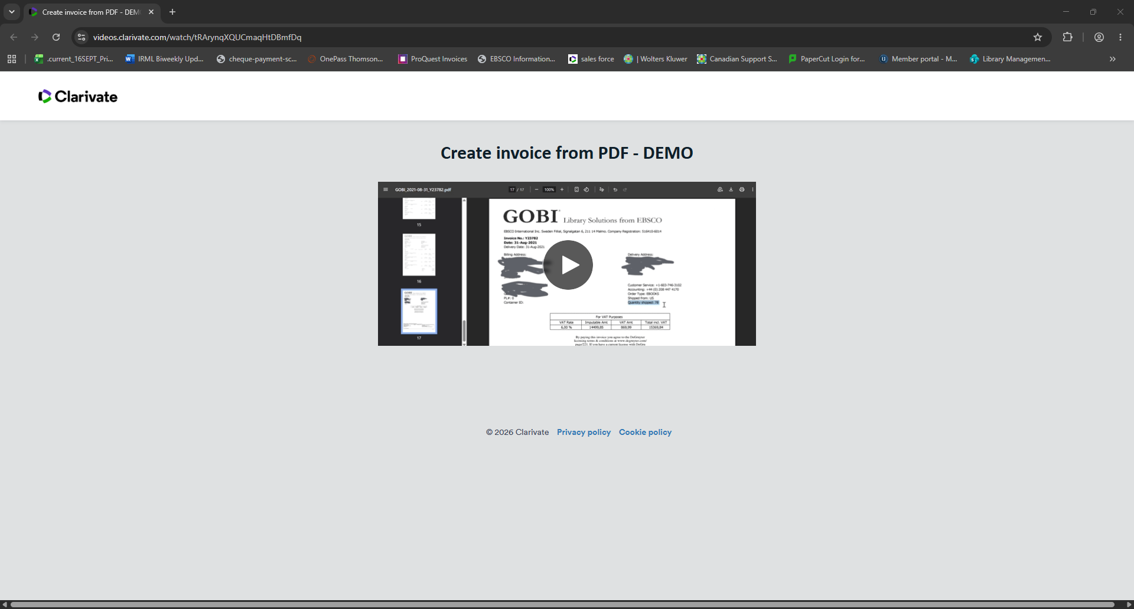
Create invoice from PDF demo
https://videos.clarivate.com/watch/tRArynqXQUCmaqHtDBmfDq

Slide 23
Review
Compare and ensure we are asking the right questions

Slide 24
Pausing for review of the first three areas of evaluation
Need for Service
Existing Capabilities
Functionality versus Hype
The real question is shifting to whether the AI workflow will be better than entering invoices manually, rather than can it replace EDI workflows. EDI functionality is the better set up.

Slide 25
Compare - Volume
EDI
AI
The number of vendors you can set up with is very low 4%
The number of invoices those vendors generate is high 80%
Can use with 100% of the vendors

Slide 26
Compare – consistent format
EDI
AI
EDI is a set and consistent format from the vendor and is predictable
AI uses what is on the invoice and vendor formats are inconsistent
Does AI consistently pull and interpret the data in the same manner every time
Can AI misinterpret the data it is "seeing"

Slide 27
Compare – Links to POLs
EDI
AI
When EDI is set up the POL is most often the match point and therefore knows where to land and what to connect with
AI can only match to the POL if the POL is printed on the invoice
AI can misinterpret the POL if the vendor adds (e.g., POL-51515/NR)
Does AI attach to a closed POL
Does AI consistently see a POL printed on the invoice

Slide 28
Compare – Additional Data
EDI
AI
Vendors can omit tax lines
Attach to POLs for service fees
Arrive with the vendor account linked
Can only interpret what is printed on the invoice
How would you handle taxes appearing on the invoice
Can a POL be linked to a service fee

Slide 29
Compare – Set Up
EDI
AI
Set and leave to autorun
Each invoice must be manipulated
Each invoice must be scanned

Slide 30
Compare – ease of tracking
EDI
AI
Set in job parameters to run at intervals as appropriate
Lands in the "in Review" queue when available
Need to track the arrival of the invoice
Where does it land? “in review” once created

Slide 31
Compare – control of feature
EDI
AI
If the file doesn't attach you can delete and reload
Consistent load parameters – pulls from the same XML provided
Control on persistent errors – speak to vendor and sort what is needed or should be omitted in XML
If the file doesn't attach do you start over
Inconsistent load new interpretations of the new scanned data
No control over persistent errors as you can't always predict what the AI is confusing

Slide 32
Costs & Impacts
  Fourth area of evaluation

Slide 33
Defining Costs and Impacts
What is measurable versus what is not
  Environmental
  Privacy
  Staff time
  Staff retention
  Staff training
  Errors
  Discernment
  Cost now
  Cost later
  Transparency
  Control

Slide 34
Matrix Categories
Number of vendors to benefit
Number of invoices
Number of invoices with multiple lines
Set up complexity
Cost now
Cost in future
Development with vendor
Changes by vendor
Maintaining knowledge and discernment
Environmental issues
Staff training
Added value to process
Control over the file and process
Transparency with vendor
Time saved
Errors reduced

Slide 35
EDI versus manual

Slide 36
Efficiencies versus efficiencies
Fifth area of evaluation

Slide 37
Efficiencies versus Efficiencies
AI versus EDI and Manual
How quick is each method?
How simple is the method?
Does it create or reduce errors?

Slide 38
EDI totals Top Scores

Slide 39
EDI totals

Slide 40
Recommendations and questions

Slide 41
Recommendation
If you haven't already set up EDI with vendors. Do it.
In anticipation of vendors pushing out more AI features we encourage everyone to develop processes for testing AI features before adoption to ensure it is advantageous and improves your process
We would highly recommend including staff in the testing process as they are impacted by AI features more immediately and are more knowledgeable about workflow realities

Slide 42
Questions?
Using Gobi but not set up for EDI? Contact - gobicustservice@ebsco.com
Using EBSCO and not set up for EDI? Contact – acampbell@ebsco.com
Want to see live examples of EDI? Contact – swhittle@wlu.ca
Interested in discussions on evaluation criteria for AI features? Contact – mthomas@wlu.ca

