Slide 1
Widening the Table:
Collaboratively Responding to Accessibility Issues in a Shared Library Service Platform
OCUL Collaborative Futures Accessibility Subcommittee
Catie Sahadath, Lynne Serviss, Dan Sich, Mark Weiler (chair)

Slide 2
Overview

Slide 3
Accessibility Subcommittee
Current members
Past members (Committee or Working Group)
Catie Sahadath, Ontario Tech
Lynne Serviss, McMaster
Dan Sich, Western
Mark Weiler, Laurier
Anika Ervin-Ward, OCUL
Lacey Caine, Carleton
Pascal Calarco, Windsor
Michelle De Agostini, York
Emily Gibson, Queen’s
Eva Lu, Waterloo
Carling Spinney, Queen’s
Paige Maylott, McMaster
Anne Newman, Queen’s
Many Deans Kassies, Brock/OCUL

Slide 4
Subcommittee purpose
Proactively identify and remove existing and potential barriers from user and staff experiences
Champion accessibility as a collective responsibility

Slide 5
The Problem

Slide 6
The Problem and Sub-Problems
Problem:
Progressively remove complex barriers that disadvantage people with disabilities.
Sub-Problems:
Ensuring complex obstacles don’t become normalized
Collaboratively responding to progressively remove them, and
Supporting an environment where we can learn to collaborate

Slide 7
Current contents of the monitoring table

Slide 8
Row 9: Book titles in languages that aren’t the same as Omni’s display language
Blind screen reader user
with Omni set to English
who encounters French titles
which are read using the English text-to-speech synthesizer
Problem/preferred outcome breaking WCAG 2.0, success criteria 3.1.2, Language of Parts, use the "lang" attribute

Slide 9
Row 10: Resource Sharing and EPUBS
Print-disabled user orders an article through RapidILL
User requires HTML or EPUB versions of articles for use in adaptive technology
Available article formats: PDF, EPUB, and HTML
RapidILL only sends PDF versions
User must contact the library to access accessible versions

Slide 10
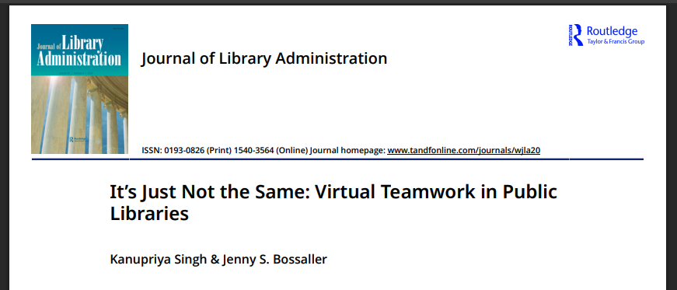
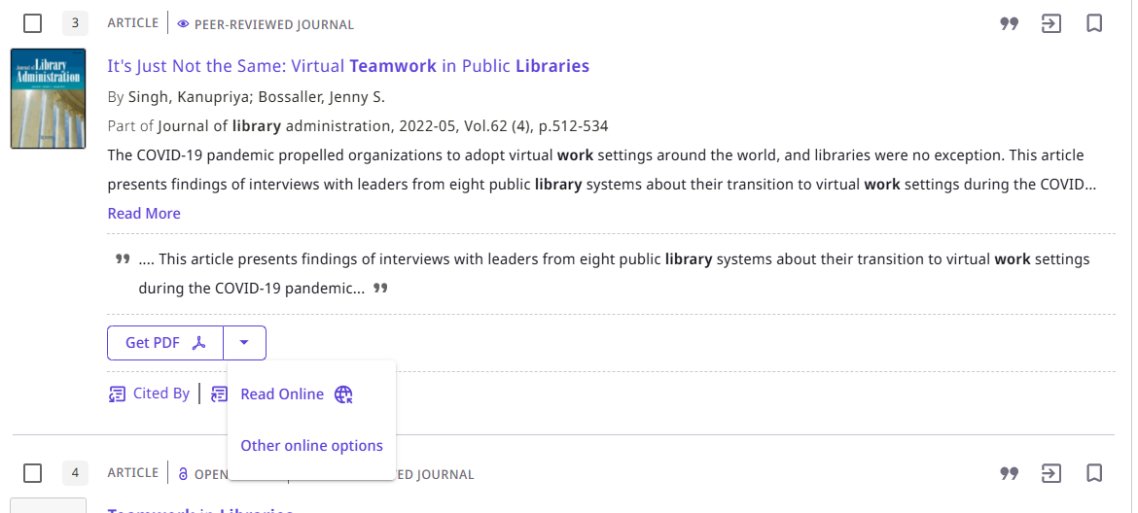
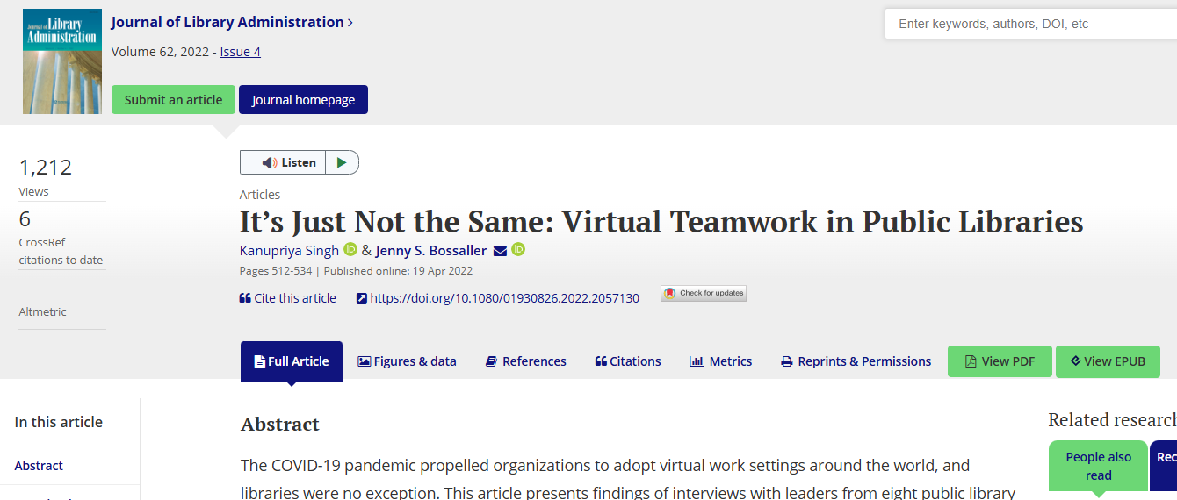
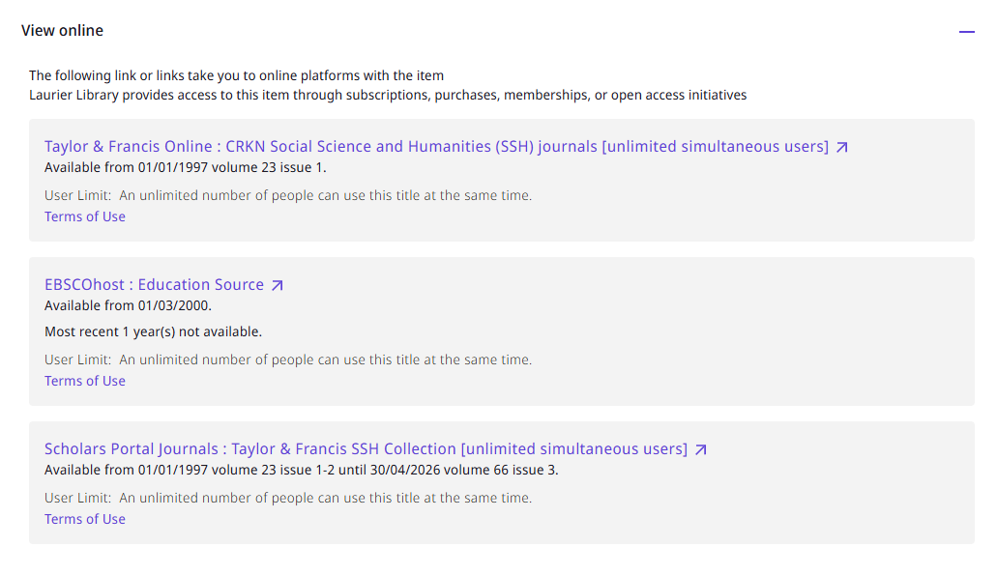
Row 8: QuickLinks

Slide 11
What is the issue?
QuickLinks are helpful:
  Helps people with disabilities who find barriers in navigating web content (e.g., full record or publisher platforms)
But QuickLinks have problems:
  Links to PDF: PDF is notoriously inaccessible for some people with disabilities
  Links to HTML: Can link to badly built HTML while high quality HTML available
The solution is not immediately obvious

Slide 12
Supporting responders
Resources on the monitoring table
  User stories
  Testing procedures
  History
Acknowledgment
  Roger Reka (Windsor) and Matt Thomas (Laurier): involved at initial stage
Current status:
  Passed 2-year mark
  Technical assessment being done
    Chris Woodley (Laurier) has joined to help
    We meet with OCUL-IR to seek subject-matter experts

Slide 13
Structure of the Monitoring Table

Slide 14
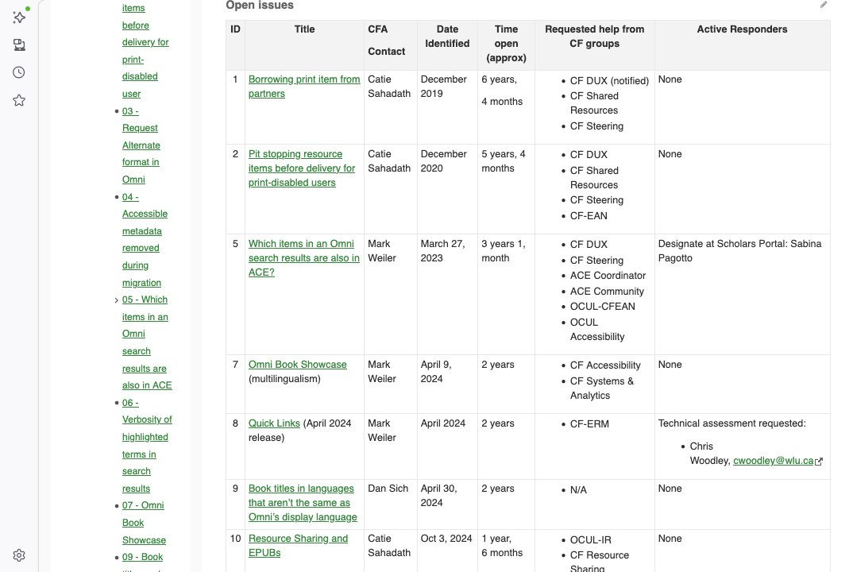
CFA Monitoring Table
Notes:
Alt text: Screenshot of webpage "SPOTDocs: OCUL: Collaborative Futures: Committees: Accessibility Subcommittee (CFA): CFA Working Documents: Monitoring table: Consortial accessibility issues” showing rows of open issues and columns for details and tracking.

Slide 15
Issue Responses and Responders

Slide 16
How we respond
Describe and define the issue with a technical assessment
Identify who may be able to help:
  Subject matter experts
  Technical experts
  Specific skills and experiences
Receive and document information on actions being taken to resolve the issues

Slide 17
How you can help
Contact the CF-Accessibility Subcommittee to:
Identify new issues
Provide updates on responses to existing issues
Provide user stories or impact statements
Gain some accessibility skills by testing solutions

Slide 18
Questions ​

