Slide 1
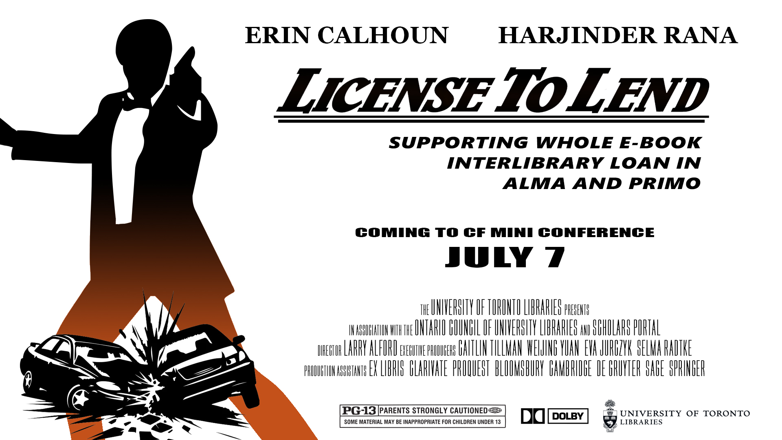
License To Lend
Notes:
Introductions

Slide 2
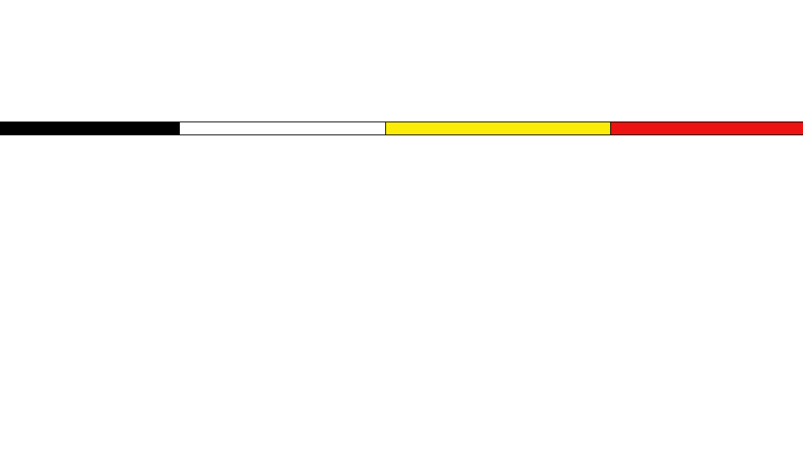
Land acknowledgement
"We wish to acknowledge this land on which the University of Toronto operates. For thousands of years it has been the traditional land of the Wendat Nation, the Seneca, and the Mississaugas of the Credit. Today, this meeting place is still the home to many Indigenous people from across Turtle Island and we are grateful to have the opportunity to work on this land."

Slide 3
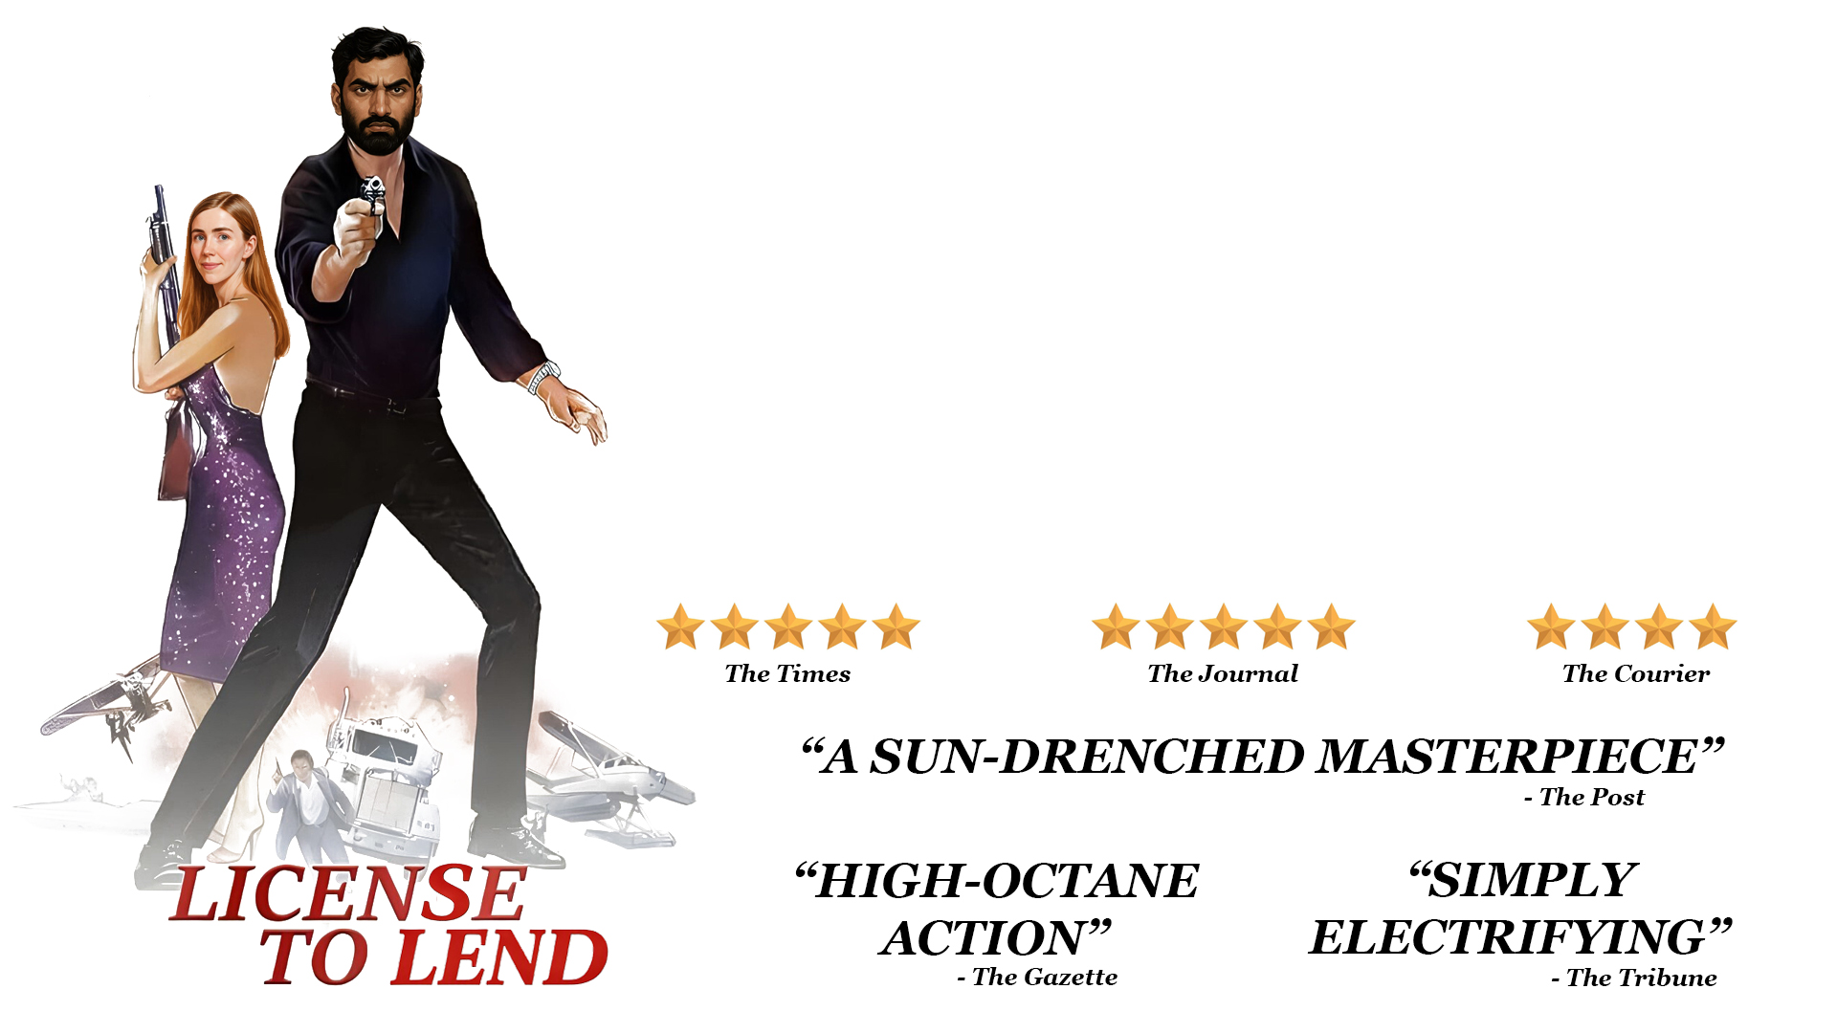
The Plot
The Plot
Why e-book lending?
Licensing ILL lending rights
How we fulfill ILL requests with e-books
Some challenges that persist
Next steps
Notes:
Agenda

Slide 4
Why e-book lending?
E-preferred collection approach
  Building electronic collection while securing broad user rights and local load rights with publishers
ILL service disruptions
  Global pandemic, labour actions, political instability/tariffs, wait times, budgets, etc. all make physical lending precarious
Non-returnable, DRM-free e-book ILL
  In contrast to other forms of electronic lending, such as CDL
Notes:
E-preferred collection policy:
UofT has ~4 million e-resources across various formats.
For books, in the last 15 or so years, the central library has built a large academic ebook collection using frontlist agreements with publishers and more recently, e-preferred approval plans.
Frontlist agreements allow the library to build relationships with publishers while acquiring annual catalogs of their published works through frontlist and backlist purchases. Through these agreements, we have also obtained broad user rights and local load access through Scholars Portal.
Over the years, it’s been important to us to build up ownership over access to ebook collections while leveraging our relationship with Scholars Portal as a repository and ebook platform.
Due to this longstanding relationship, we have been able to acquire local load rights for all our major ebook frontlist agreements. This secondary source of access, alongside the publisher platform, is beneficial when there’s an access issue on the publisher site, or we’re seeking to fulfill ILL requests.
ILL service disruptions:
All these issues nudged us to desire alternatives to shipping physical books
Tariffs were the last straw
Non-returnable, DRM-free e-book ILL:
Labour is an issue as well, want the most familiar workflow to our staff with the least amount of new work
Today we are talking about a workflow no different from sending a book chapter or a journal article which we've been doing for many years
CDL can involve digitization, pulling the print copy out of circulation, etc.
DRM e-book lending can involve platform restrictions such as tokenized access, e-readers, limited viewing duration, etc.

Slide 5
Licensing ILL lending rights
Publisher | Number of titles
Bloomsbury | 52,770
Cambridge University Press | 36,074
De Gruyter Brill | 207,639
Sage | 16,098
Springer | 21,712
TOTAL: | 334,293
Updated license terms with 5 publishers to include full e-book ILL
Approximately *964,000 e-books are available via frontlist agreements
283,823* are now available for full e-book ILL
*Scholars Portal copies not counted in final total
Notes:
Over past year or so, we have secured additional ILL rights that explicitly and clearly permits full ebook ILL. To date, we have full ebook ILL rights, with some minor carve-outs, for 5 major publishers that we purchase frontlist collections from.
A rough calculation of the number of ebooks we have received from publishers is just about 964,000.
Of that total, 334 000 are available for full ebook ILL.
These numbers exclude Scholars Portal copies, which should theoretically be a 1:1 relationship with the publisher copy and total count.

Slide 6
Reflecting licenses in Alma
ILL General: permitted/prohibited
ILL Secure Electronic: permitted/prohibited
ILL Electronic (email): permitted/prohibited
Interlibrary loan note: free-text
  Ex. May only distribute in Canada; may only share 5% of overall work; "Full ebook ILL is permitted"
For your ILLs only… In Alma, license terms can be re-ordered, made visible/hidden to public view, and customized
Notes:
So we have these rights, now what?
We will need to display these rights in our catalogue so that users, ILL staff both internal and external to UofT know that the full ebook can be requested or borrowed.
This work starts in Alma and goes through our Collection Services department.
First, a final license is reviewed and license terms are entered into a local spreadsheet for record keeping.
Then, license terms from the spreadsheet are entered into Alma's license module. Of specific interest for this presentation, we code the following ILL terms: ILL general (print), ILL secure electronic, ILL electronic (email). These are all standard permissions that would be outlined in a license's permitted uses.
We also use "Interlibrary loan note" to indicate if there are specific conditions to requesting or borrowing the electronic materials, such as may only distribute in Canada, or a specific amount. This is the field where we indicate if full ebook is allowed with the standard language "Full ebook ILL is permitted".
Sidenote, since UofT is not part of CF, we don't operate ​or see the network zone and all our licenses are entered and assigned to inventory manually.

Slide 7
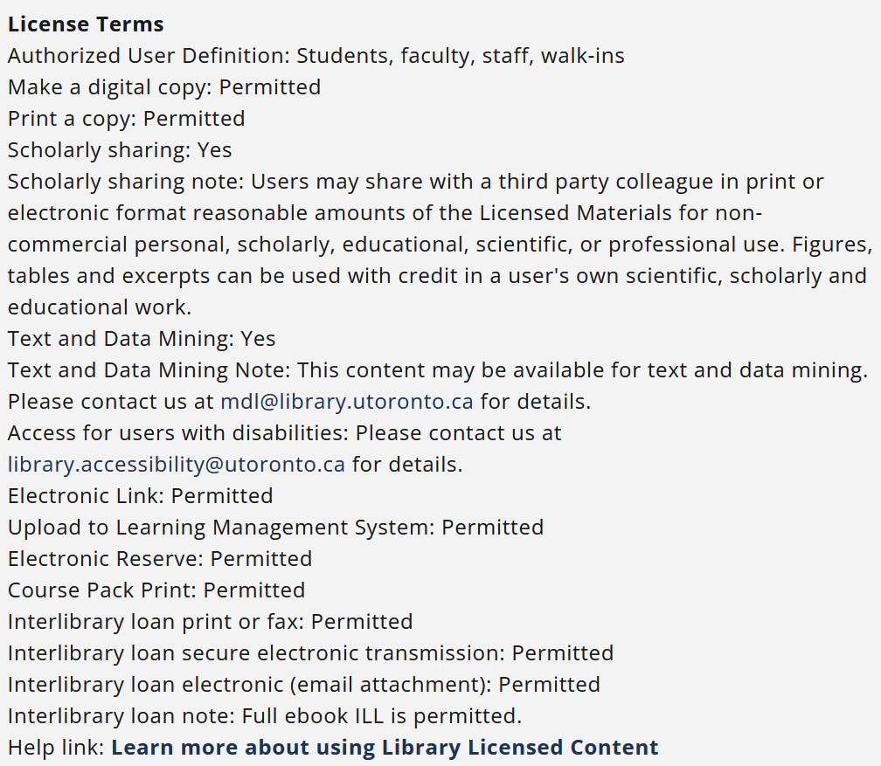
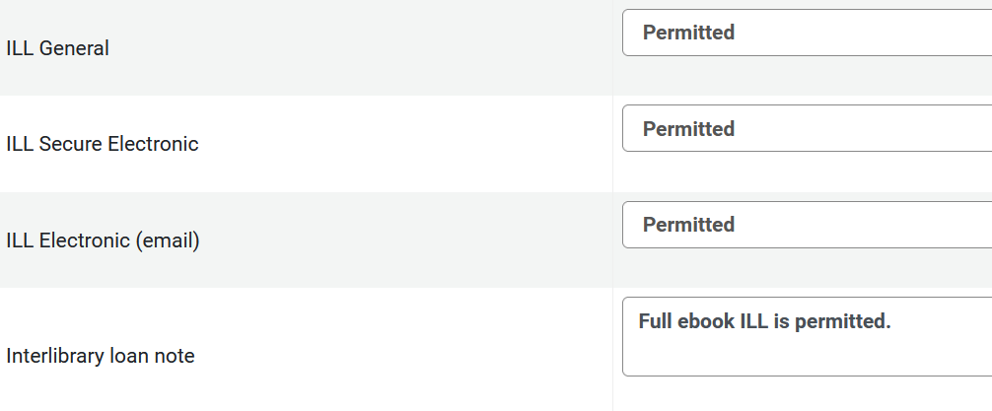
From Alma to LibrarySearch (Primo)
Notes:
Within Alma's configurations, you can determine what terms and values display to in the public catalogue. Meaning, you can enter a value in Alma and choose to note display it in Primo. For ILL, we opted to display all relevant terms to help staff make determinations about ILL availability.
The screenshot on the left is the Alma license values and the screenshot on the right is how this appears in Primo. We also include a hyperlink in our license terms to a page which describes suitable use of licensed e-resources and definitions of terms listed here.

Slide 8
Adding licenses to Alma
Internal license notes:
  Viewable to staff in Alma only; record whether license includes mention of Section 29 or 30 of Canadian Copyright Act
Fair dealing clause:
  Viewable in public catalogue; record whether license explicitly mentions a copyright framework (Canada, United States, and/or international)
Notes:
We also record some additional information that may be relevant when evaluating the availability of our collection to support library services, such as ILL.
If a license includes mention of section 29 or 30 f the Canadian Copyright Ace, I will enter a note on the license's profile in Alma indicating as such.
As well, we will also record whether the license recognizes a Canadian legal framework, such as copyright.
Editing licenses in Alma is very manual. We're not aware of any jobs that can be run to update license terms, so it is useful to be exhaustive in what is recorded in case if proves useful at some point in the future. Otherwise, you'd need to go back to the main license for review and update individual licenses manually.

Slide 9
Steps for adding licenses in Alma
License is added to our local coding sheet
License terms are added to Alma: either as new license OR updating existing license in Alma with new terms
Let Metadata colleagues know to assign license to electronic inventory
You only license twice… create two licenses to manage conflicting ILL information
Some resources in a license may not ILL at all but all other licensed materials are full ebook ILL. Solution: create 2 licenses in Alma (1 pro-ILL, 1 anti-ILL).
Notes:
So at this point the license has been finalized, entered into a local coding sheet and has been entered in Alma.
If the license is an amendment to an original contract, i.e. to add full ebook ILL, I will update the existing license in Alma so the current linked electronic holdings will inherit the new license language. From there, our metadata staff will activate records for the newly acquired resources.
For some licenses where there may be carve outs, such as specific content like data or videos may not ILL but all other resources can, the workaround for this has been to create two licenses: one with ILL and one without ILL permissions, and then assign inventory to the correct license.

Slide 10

From Alma With Love
Notes:
How we fulfill ILL requests with e-books
Choice of wording is deliberately not "how to fulfill e-book ILL requests" because we get few of those, instead we mostly get loan requests that we choose to fulfill with e-books

Slide 11
Confirm your Alma settings
Configuration > Resource Sharing Library > Library Management > Library Details > Summary > Lending Setup > Ignore electronic resources for physical-only requests = No
Configuration > Resource Sharing Library > Library Management > Library Details > Summary > Lending Setup > Reject request when only electronic available = Unchecked
Configuration > University of Toronto > Fulfillment > General > Other settings > rs_ignore_electronic_for_physical_request = False
Notes:
Our settings may be different from collaborative futures
Ignore electronic resources for physical only requests: If we receive a request for a physical book, we want Alma to offer us the chance the lend the e-book if we have it
Reject request when only electronic available: Had this set to yes when none of our e-books had lending rights, otherwise we would be manually cancelling all these requests
Can configure further electronic rejection rules (e.g. we have one when secure electronic transmission is prohibited, e.g. we can't lend it so it auto rejects)
Customer parameter seems to do same as config 1, but it is at the institutional level so we just set it to false to match (maybe if you have more than 1 resource sharing library?)

Slide 12
Fulfilling requests…
When we have an e-book:
Notes:
First scenario of 2 we will demo

Slide 13
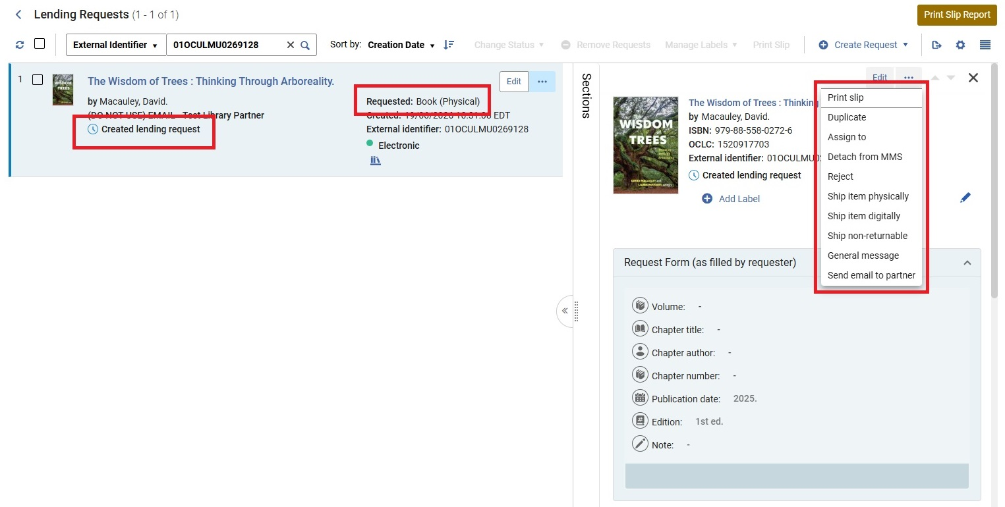
Fulfilling Request Ebook only: Step 1
Notes:
If a match is found, request will arrive to our lending queue with the request status "Created lending request"
Most requests for books arrive with the requested format "Book (Physical)"
Because it matched to an e-book holding, there is no option to create move request or create digitization request as we are accustomed to seeing. Also, there is no option to download electronic resource because the request is physical

Slide 14
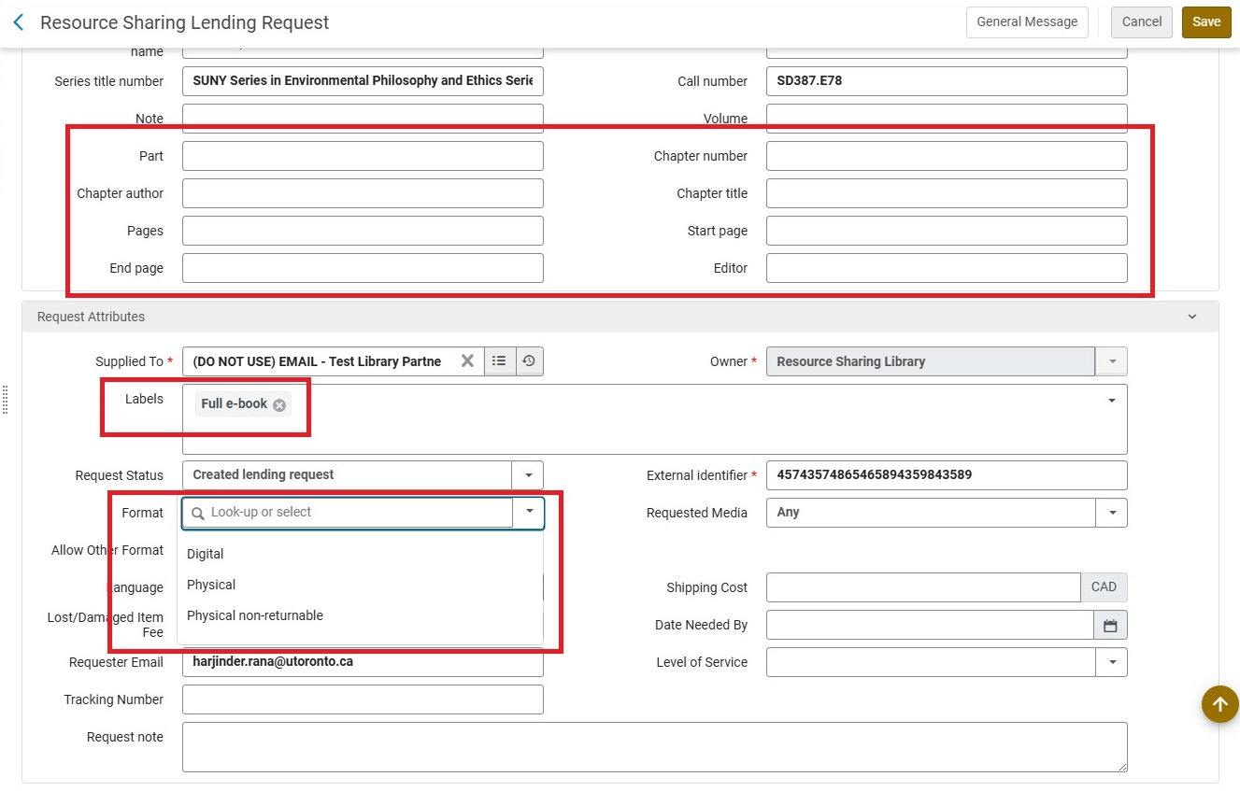
Fulfilling Request Ebook only: Step 2
Notes:
We need to edit the request details to properly download the resource
Change the format from physical to digital
OPTIONAL: Add a label to identify it as an e-book request (for analytics)
Remove any details that would identify the request as a portion (e.g. someone writes into the form "whole e-book please", etc.)
Another example re: chapters, we get some chapter requests through RapidILL for more than 1 chapter from the same title, if we can supply the whole e-book we will
Save

Slide 15
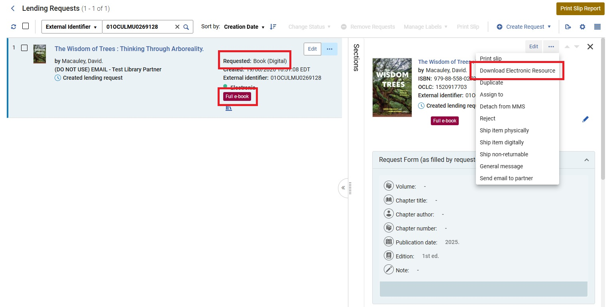
Fulfilling Request Ebook only: Step 3
Notes:
Requested format changes to "Book (Digital)"
Label is applied (for analytics and creates a facet)
Can now download electronic resource

Slide 16
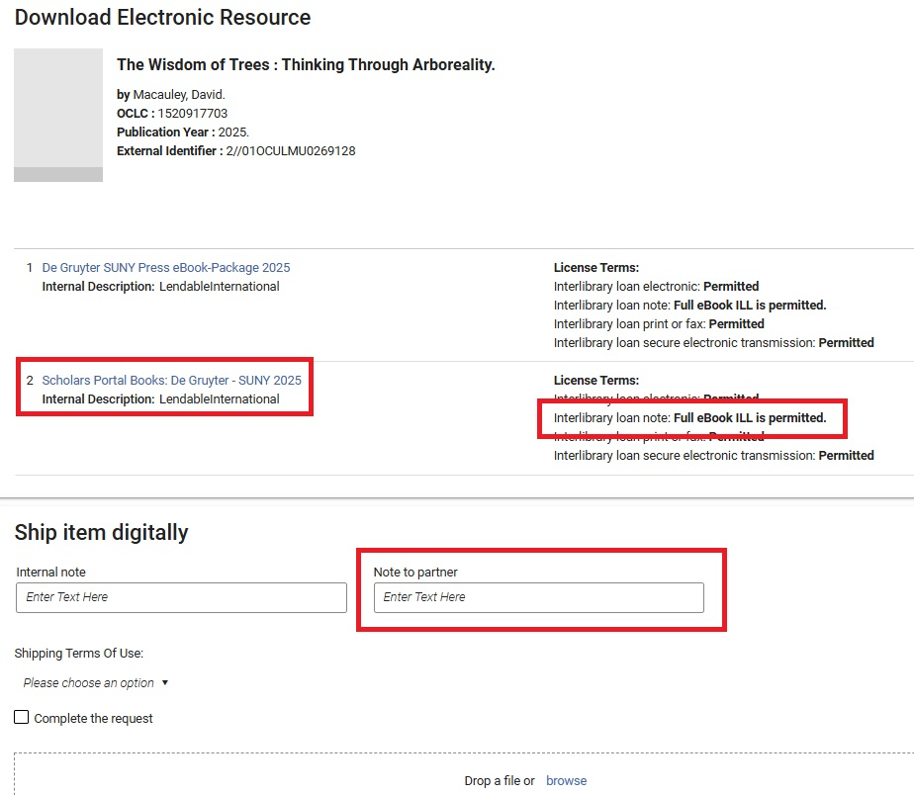
Fulfilling Request Ebook only: Step 4
Notes:
Can now see the license terms
Confirm interlibrary loan note reads "Full ebook ILL is permitted", if not then non-supply the request
OPTIONAL: Add a note to partner that our license permits full e-book lending
Go to vendor platform to download the file, then upload and submit
More on download process later in the presentation

Slide 17
Fulfilling requests…
When we have an e-book AND a print copy:
Notes:
"E-preferred ILL", unless explicitly stated in the request that the print is needed (implications for accessibility)
Slightly more involved

Slide 18
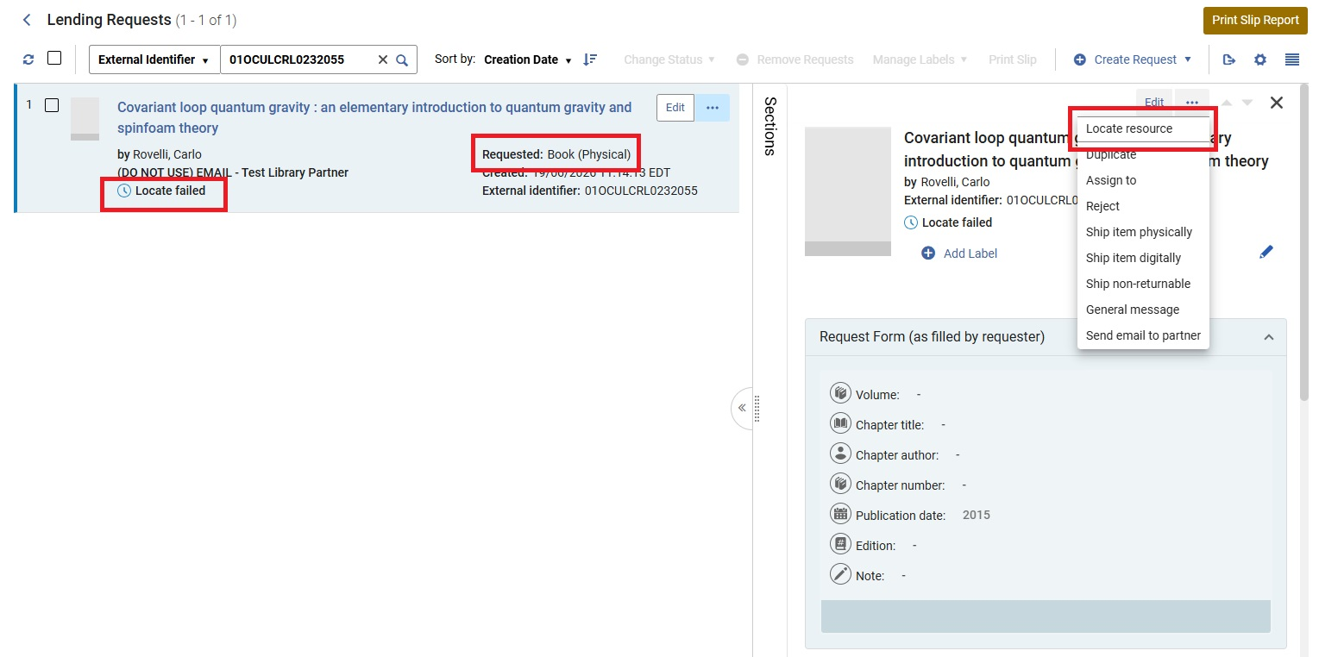
Fulfilling Request Ebook and Print: Step 1
Notes:
Match is suspected, but arrives to the lending queue as Locate failed because there's multiple holdings we need to choose from
Note that this request also arrived with requested format "Book (Physical)"
Click on locate resource

Slide 19
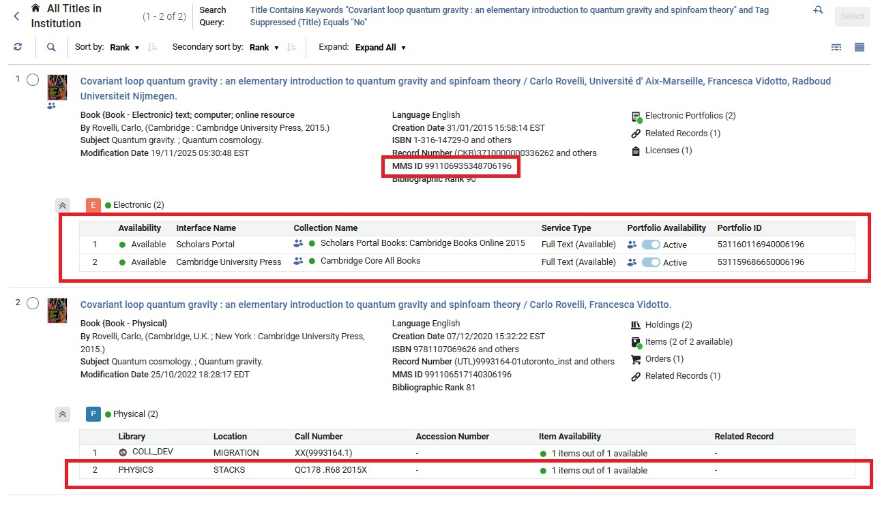
Fulfilling Request Ebook and Print: Step 2
Notes:
Print holding and electronic holding to pick from
Unfortunately, no way to confirm the license terms from this screen
Can select the electronic holding and then go through the same steps in the previous example, but if the license terms don't permit then you must detach the request and run another locate to link to the print holding
Not a bad option but I prefer to stay on this screen, take the MMS ID from the electronic holding and search Primo in another tab to check the license terms, then return to this screen and make an informed decision on which holding to select
If license doesn't permit e-book ILL, select the print holding and a move request will be created
If license does permit e-book ILL, select the electronic holding

Slide 20
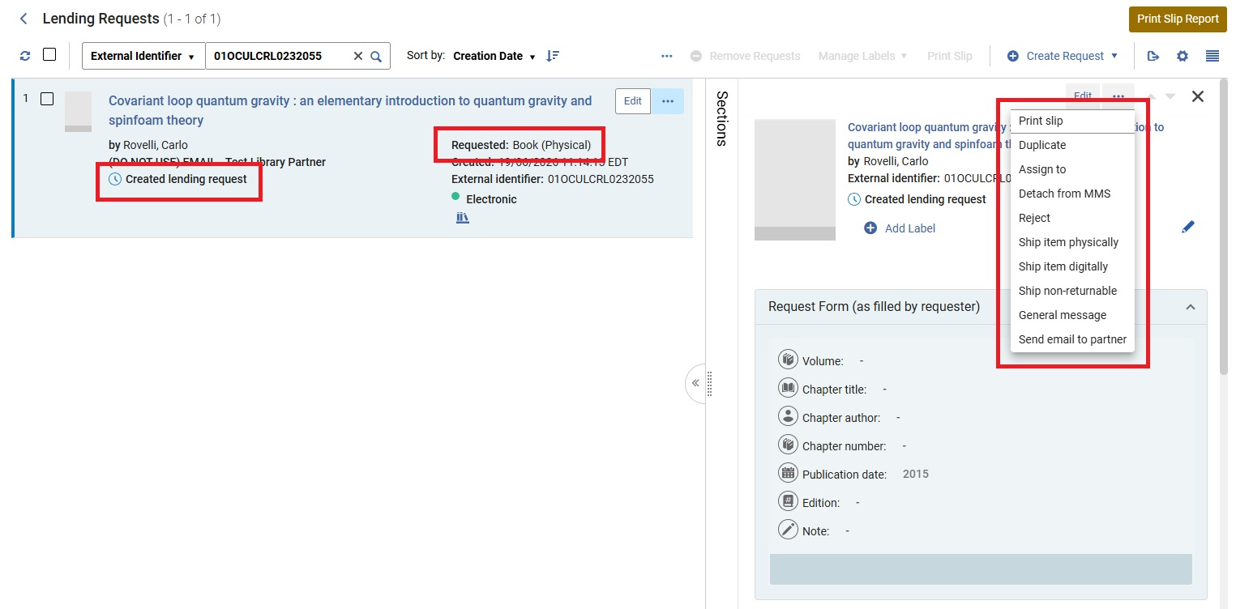
Fulfilling Request Ebook and Print: Step 3
Notes:
From here, everything is the exact same as our first example and we repeat the same steps

Slide 21
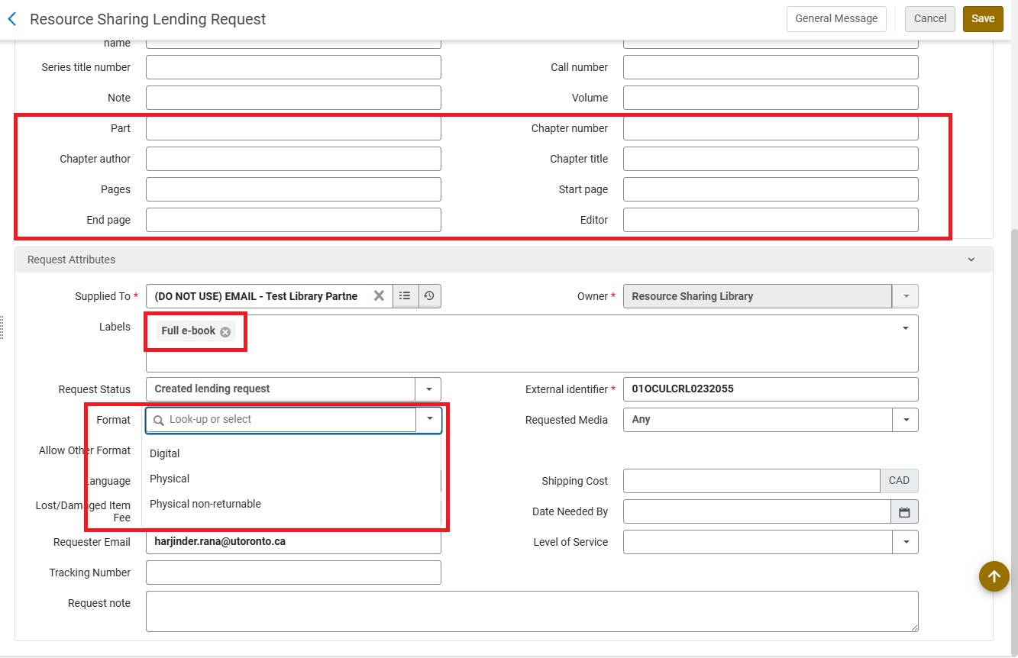
Fulfilling Request Ebook and Print: Step 4
Notes:
We need to edit the request details to properly download the resource
Change the format from physical to digital
OPTIONAL: Add a label to identify it as an e-book request (for analytics)
Remove any details that would identify the request as a portion (e.g. chapter, page numbers, etc.)
Save

Slide 22
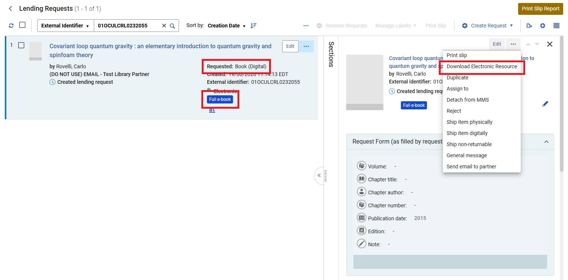
Fulfilling Request Ebook and Print: Step 5
Notes:
Requested format changes to "Book (Digital)"
Label is applied (for analytics and creates a facet)
Can now download electronic resource

Slide 23
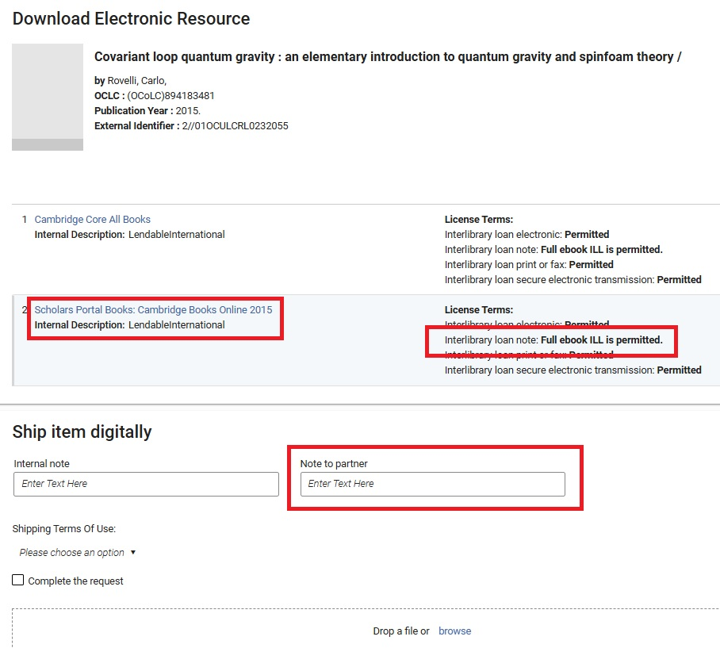
Fulfilling Request Ebook and Print: Step 6
Notes:
Can now see the license terms
Confirm interlibrary loan note reads "Full ebook ILL is permitted", if not then non-supply the request
OPTIONAL: Add a note to partner that our license permits full e-book lending
Go to vendor platform to download the file, then upload and submit
More on download process later in the presentation

Slide 24

Our lending numbers so far
June 4th to June 23rd, 2026:
Total e-books loaned via Alma = 29
  Only an e-book copy
  in our collection = 8
  Both e-book and print copies
  in our collection = 21
Notes:
Data will be updated up to July 6 for presentation on July 7

Slide 25

Challenges
Normalizing e-book lending
Facilitating requests on the borrowing side
Downloading a full PDF on some vendor platforms
Transmitting large file sizes
Negotiating more licenses and addressing vendor concerns
Notes:
Normalizing e-book lending
Still a lot of skepticism, novelty
Tend to put restrictions on ourselves, read license agreements conservatively rather than exercise our rights
Lucky that our colleagues, supervisors have been very enthusiastic
Facilitating requests on the borrowing side:
Few libraries (including us) allow users to explicitly submit requests for e-books in their borrowing request forms
Not enough of a critical mass of libraries lending e-books, fear that we set unrealistic expectations that we can get them
Need to modify requests on our end for the time being
Downloading a full PDF from some vendor platforms:
Ebook platform UI and technology hasn't kept up with our licenses and for some vendors we can only download chapter PDFs.
In cases where a full ebook isn't available for download as 1 single file, request through sales rep (and refer back to license when sending in request)
Providing feedback to vendors through reps that lack of option to download or request full ebooks is inconvienent to carrying out normal library activities, such as ILL.
Not all e-books on Scholars Portal Books can be downloaded full text, so we have a workaround to get a ful text PDF from ACE using an admin token
Not all e-books on other vendor platforms can be downloaded full next, or at least not easily (e.g. download all chapters and merge in ABBYY FineReader), so we contact Erin to obtain a file on our behalf
Need to make this need explicit when negotiating ILL rights
Transmitting large file sizes:
Have been very lucky so far that almost all e-book files have been very manageable (<5 MB)
One example when vendor sent us a zip file (can't deliver that through Alma) and it was >90 MB (also can't send that through Alma)
Negotiating more licenses:
License negotiation tactics: bring up full ebook ILL as library priority; continuity of normal library services; full ebook ILL delivery is now an expectation of users since libraries may only have an electronic version/it is more readily available.
Vendors potentially worries about unlimited sharing of ebooks through ILL and market displacement of their catalogue. ILL has low market impact and ILL and publishing and coexisted for a while. Also useful to explain how the full ebook ILL process works (and how it may not differ from regular ILL practices) and be ready with prepared language.

Slide 26

What's next?
Advocacy and awareness
  The Boston Library Consortium has been a leader in this area
ILL rights part of all future license negotiations
E-book ILL for out of copyright print books at Downsview
  In partnership with the Internet Archive
E-book lending outside Alma Resource Sharing
  OCLC WorldShare, Rapido
Notes:
Advocacy:
Getting the word out to the ILL community through talks like this
BLC e-book ILL lender tracker - https://blc.org/e-book-ill-lender-tracker
BCL digital lending toolkit - https://dlt.blc.org/
BCL digital lenders forum - https://blc.org/digital-lenders-forum
ILL rights part of all future license negotiations:
Full ebook ILL is now a normal expectation of our library services and we are making efforts to add this permitted use in frontlist renewals through new licenses or amendments, where appropriate.
Downsview:
Internet Archive now has a scribe stationed at Downsview as of a few weeks ago, we're working on a project to intercept physical ILL requests from the Downsview collection, have them scanned to Internet Archive and fulfill the ILL request with a link
Internet Archive might also offer some possibilities around CDL, will investigate further
Outside Alma resource sharing
We also lend through OCLC WorldShare, especially to international libraries, profiled group for whole e-book lending (EBOK) (approx. 30 members)
Rapido has an e-book lending pod

Slide 27

The End

Slide 28
Thank you
Erin Calhoun, Electronic Resources Librarian erin.calhoun@utoronto.ca
Harjinder Rana, Resource Sharing Librarian harjinder.rana@utoronto.ca

