Slide 1
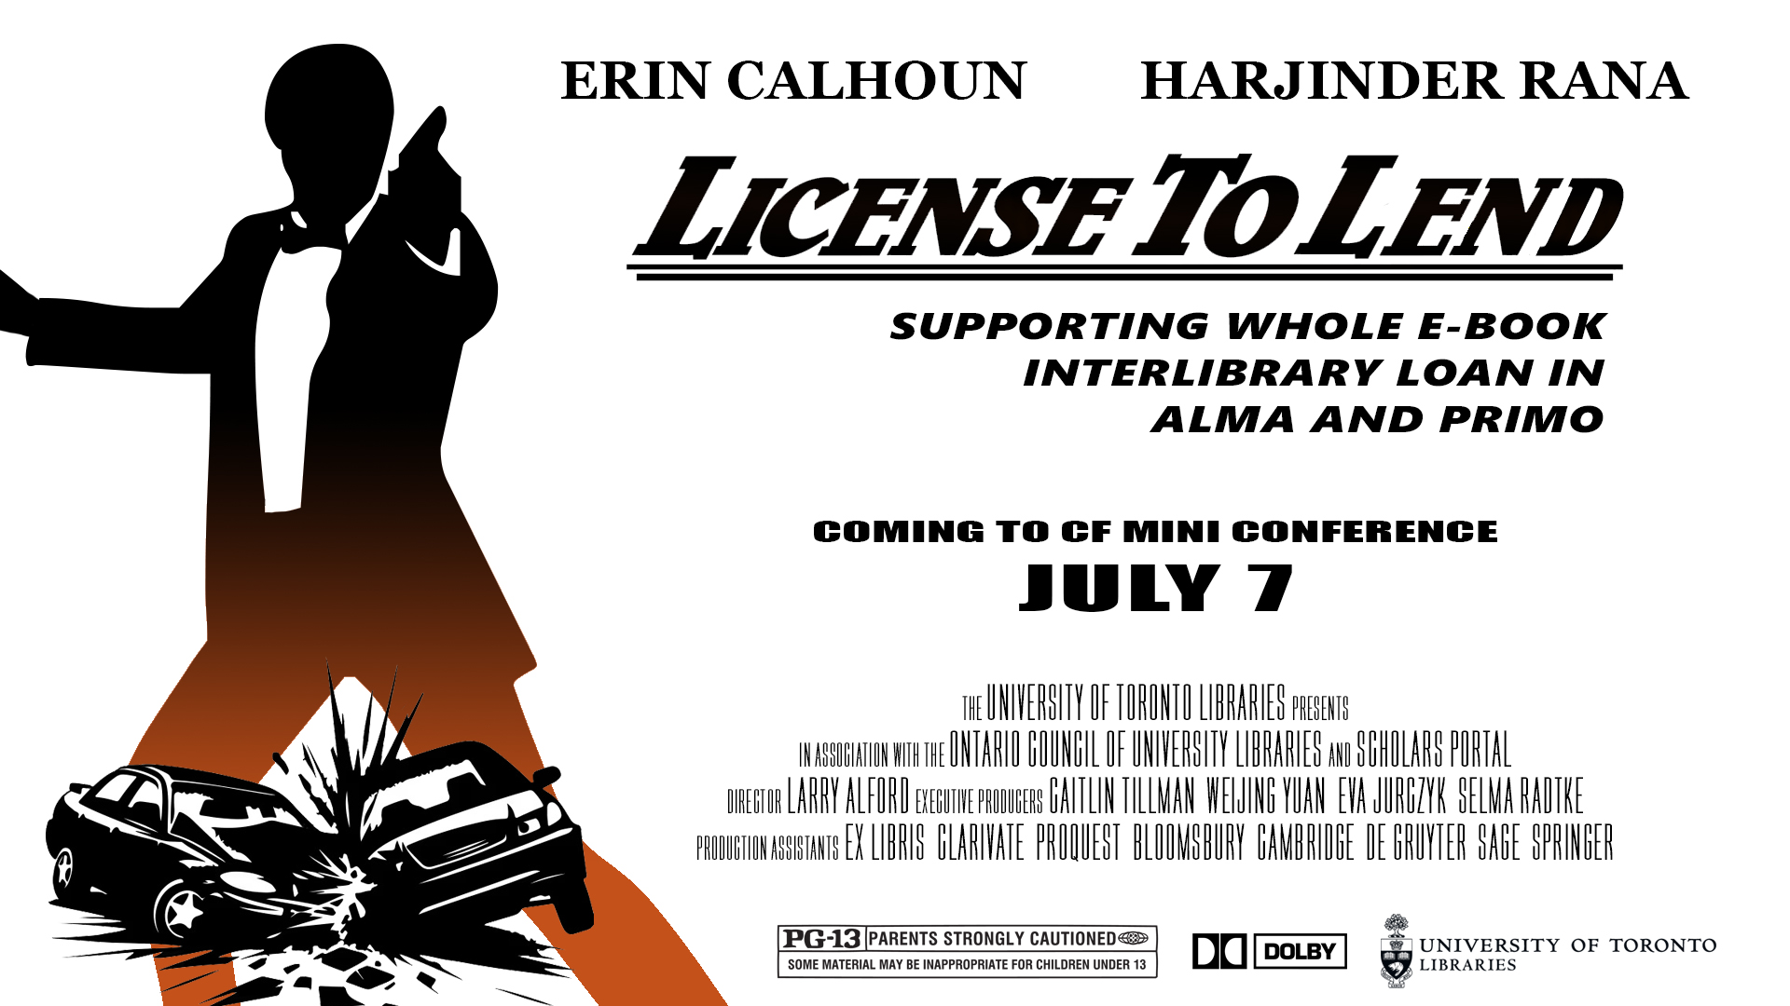
License to Lend

Slide 2
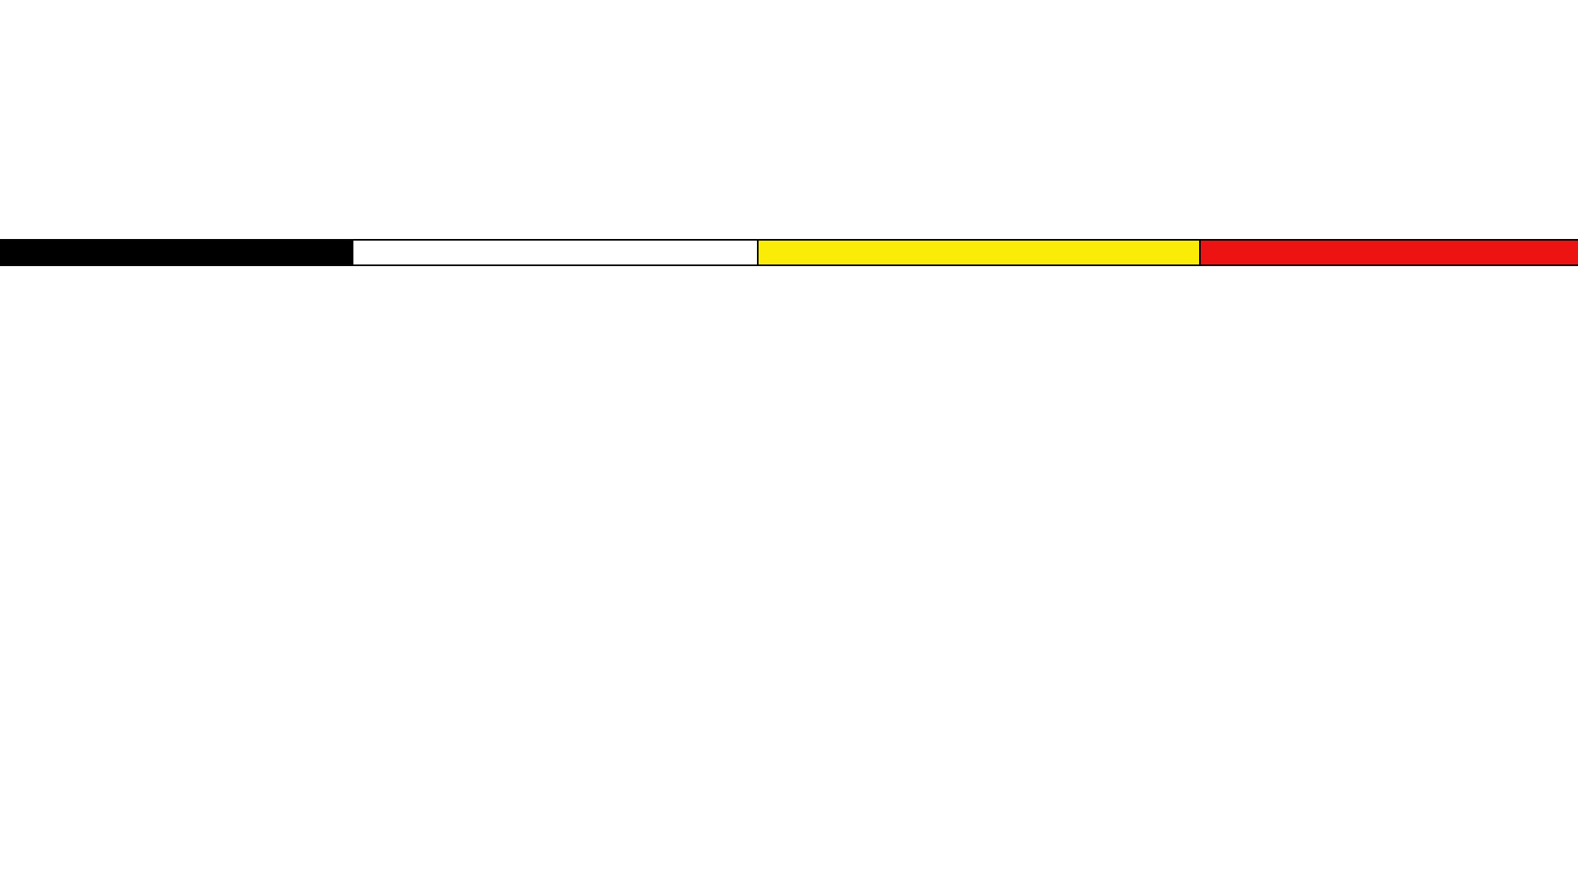
Land acknowledgement
"We wish to acknowledge this land on which the University of Toronto operates. For thousands of years it has been the traditional land of the Wendat Nation, the Seneca, and the Mississaugas of the Credit. Today, this meeting place is still the home to many Indigenous people from across Turtle Island and we are grateful to have the opportunity to work on this land."

Slide 3
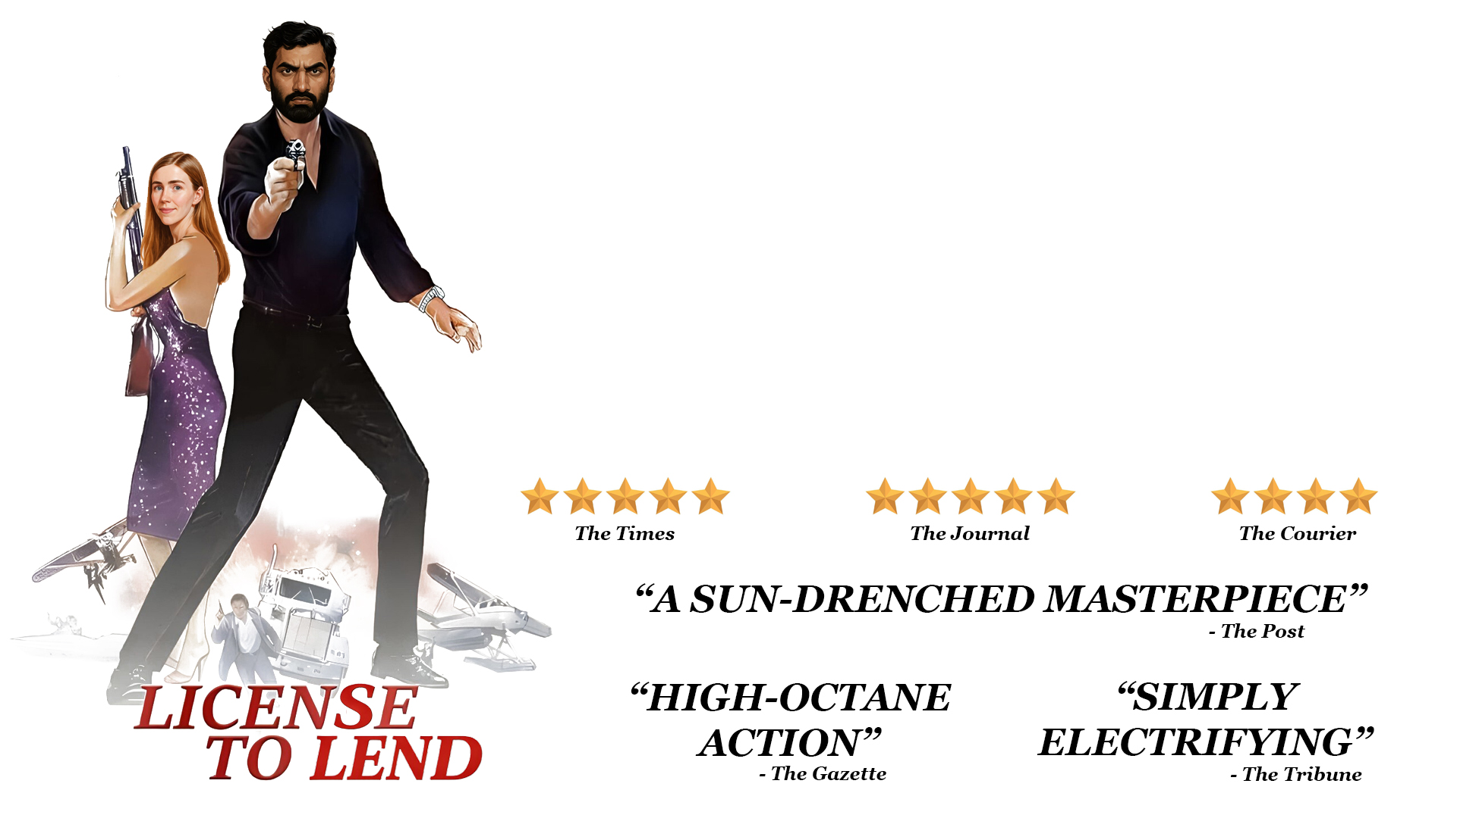
The Plot
The Plot
Why e-book lending?
Licensing ILL lending rights
How we fulfill ILL requests with e-books
Some challenges that persist
Next steps

Slide 4
Why e-book lending?
Non-returnable, DRM-free e-book ILL
  In contrast to other forms of electronic lending, such as CDL
ILL service disruptions
  Global pandemic, labour actions, political instability/tariffs, budgets, etc. all make physical lending precarious
E-preferred collection approach
  Building electronic collection while securing broad user rights and local load rights with publishers

Slide 5
Licensing ILL lending rights
Publisher | Number of titles
Bloomsbury | 52,770
Cambridge University Press | 36,074
De Gruyter Brill | 207,639
Sage | 16,098
Springer | 21,712
TOTAL: | 334,293
Updated license terms with 5 publishers to include full e-book ILL
Approximately *964,000 e-books are available via frontlist agreements
283,823* are now available for full e-book ILL
*Scholars Portal copies not counted in final total

Slide 6
Reflecting licenses in Alma
ILL General: permitted/prohibited
ILL Secure Electronic: permitted/prohibited
ILL Electronic (email): permitted/prohibited
Interlibrary loan note: free-text
  Ex. May only distribute in Canada; may only share 5% of overall work; "Full ebook ILL is permitted"
For your ILLs only… In Alma, license terms can be re-ordered, made visible/hidden to public view, and customized

Slide 7
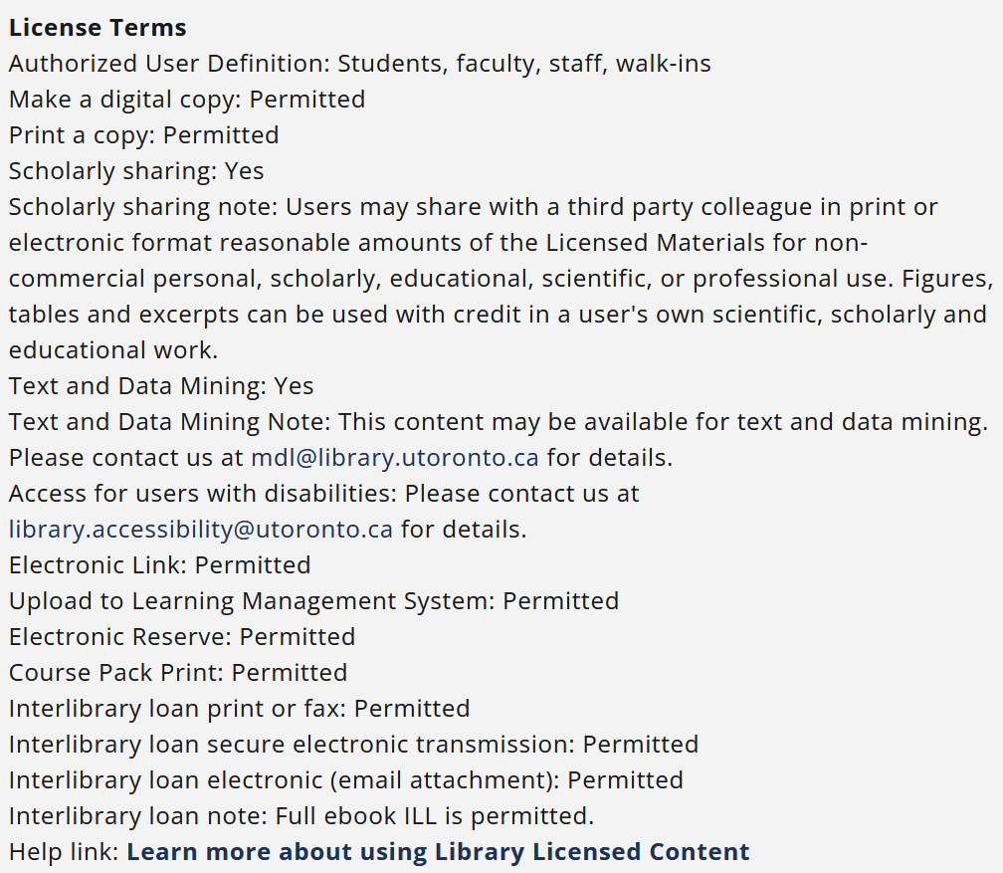
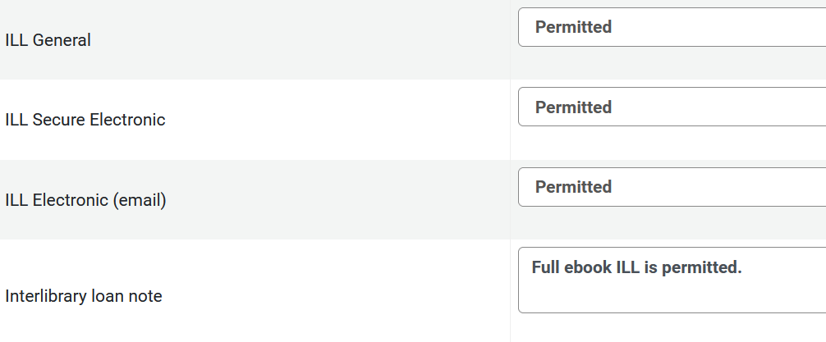
From Alma to LibrarySearch (Primo)

Slide 8
Adding licenses to Alma
Internal license notes:
  Viewable to staff in Alma only; record whether license includes mention of Section 29 or 30 of Canadian Copyright Act
Fair dealing clause:
  Viewable in public catalogue; record whether license explicitly mentions a copyright framework (Canada, United States, and/or international)

Slide 9
Steps for adding licenses in Alma
License is added to our local coding sheet
License terms are added to Alma: either as new license OR updating existing license in Alma with new terms
Let Metadata colleagues know to assign license to electronic inventory
You only license twice… create two licenses to manage conflicting ILL information
Some resources in a license may not ILL at all but all other licensed materials are full ebook ILL. Solution: create 2 licenses in Alma (1 pro-ILL, 1 anti-ILL).

Slide 10

From Alma with Love

Slide 11
Confirm your Alma settings
Configuration > Resource Sharing Library > Library Management > Library Details > Summary > Lending Setup > Ignore electronic resources for physical-only requests = No
Configuration > Resource Sharing Library > Library Management > Library Details > Summary > Lending Setup > Reject request when only electronic available = Unchecked
Configuration > University of Toronto > Fulfillment > General > Other settings > rs_ignore_electronic_for_physical_request = False

Slide 12
Fulfilling requests…
When we have an e-book:

Slide 13
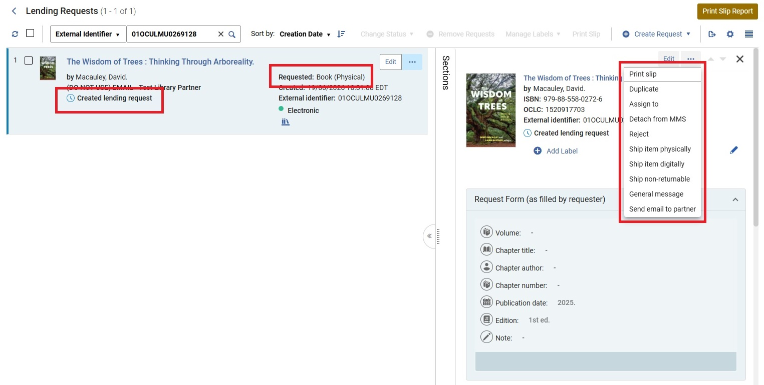
Lending Requests screenshots

Slide 14
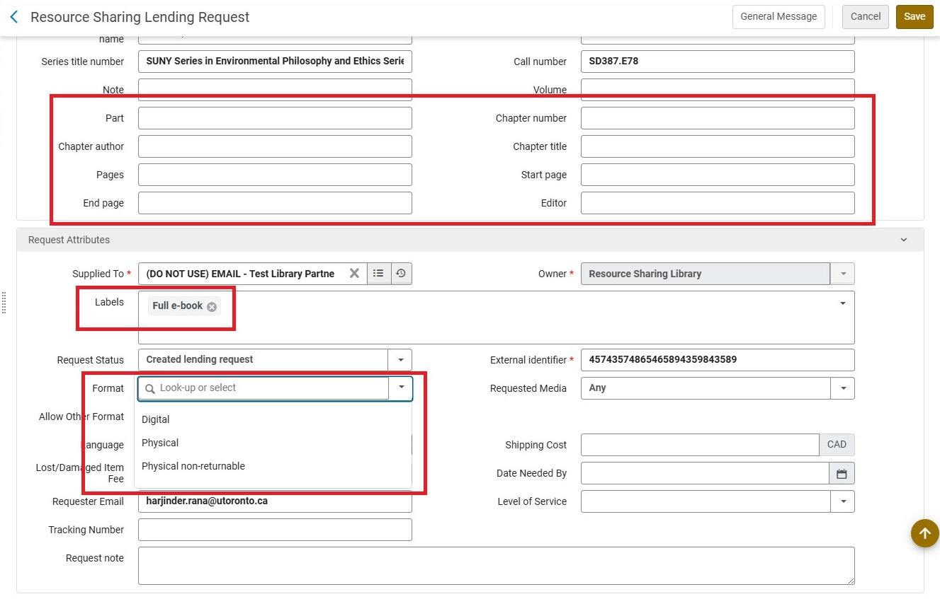
Resource sharing lending request example

Slide 15
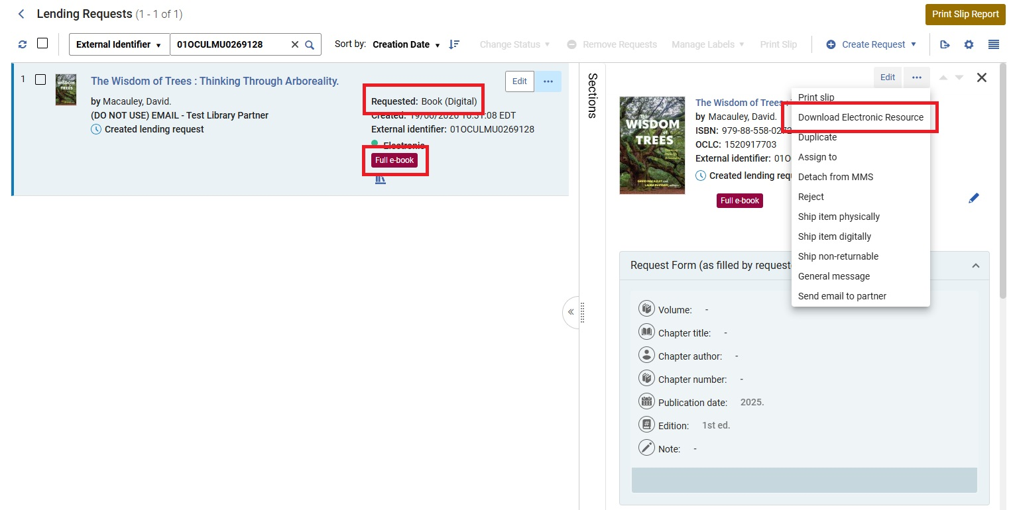
Lending requests screenshots (2)

Slide 16
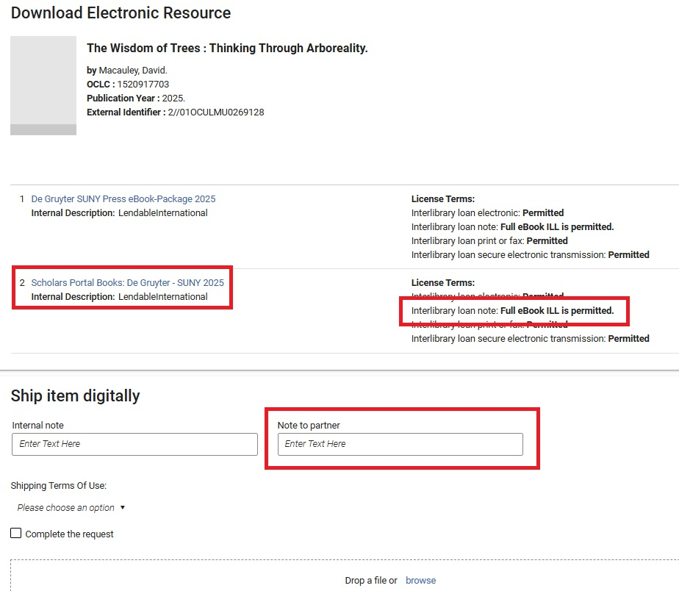
Download e-resource screenshot

Slide 17
Fulfilling requests…
When we have an e-book AND a print copy:

Slide 18
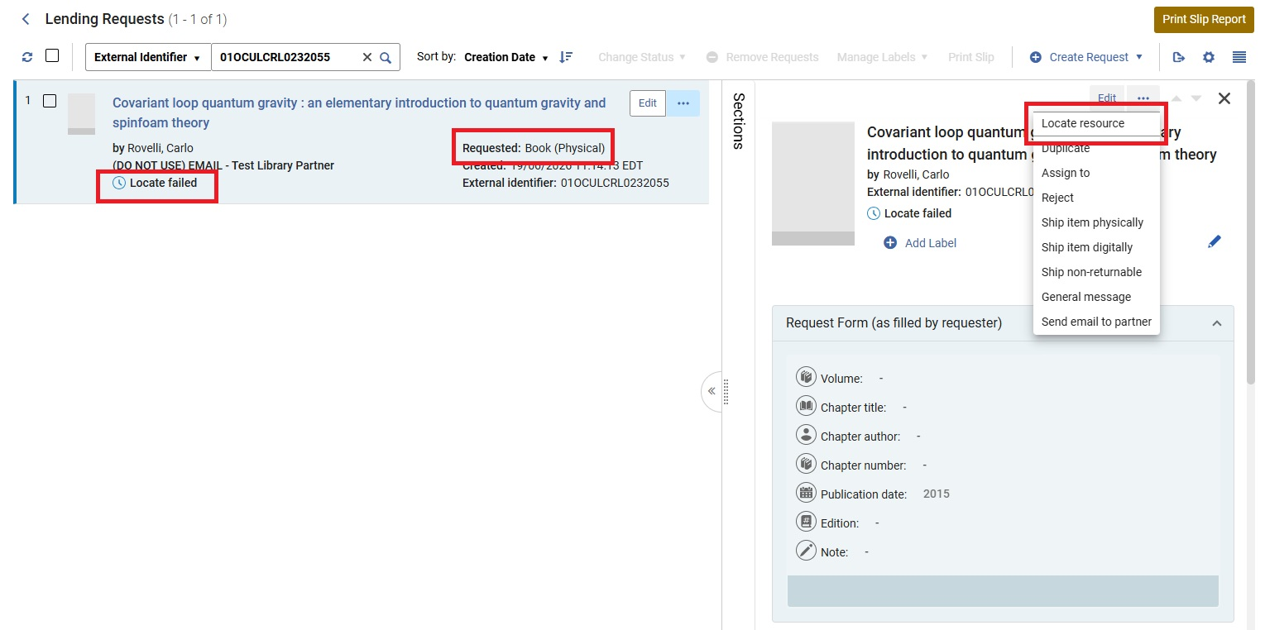
Lending requests screenshots (3)

Slide 19
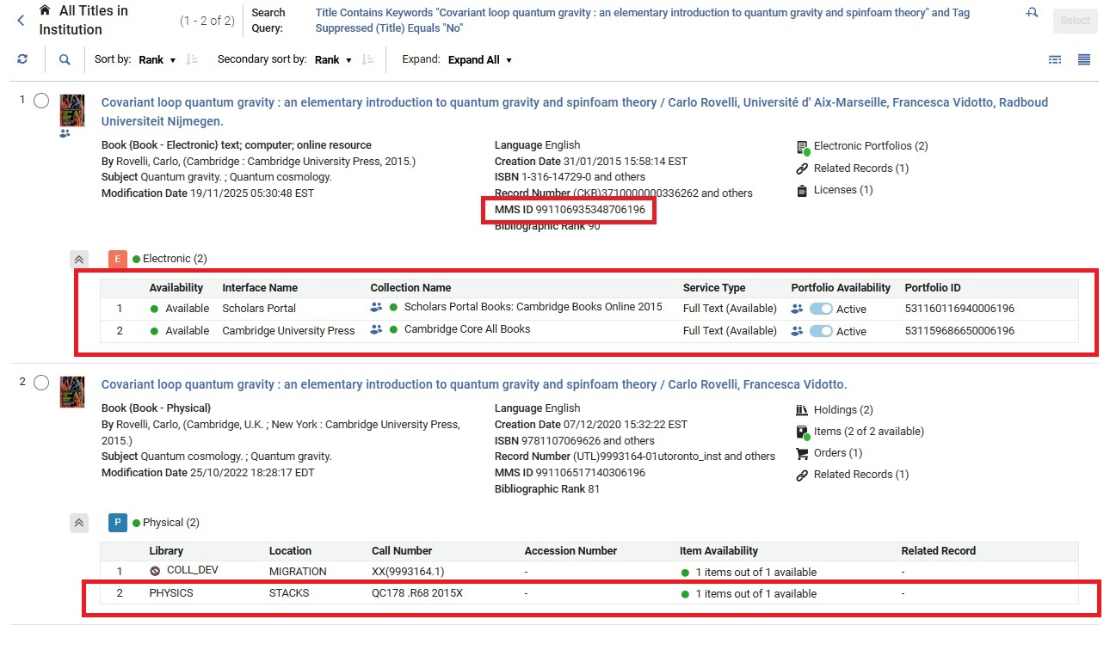
Holdings screenshot

Slide 20
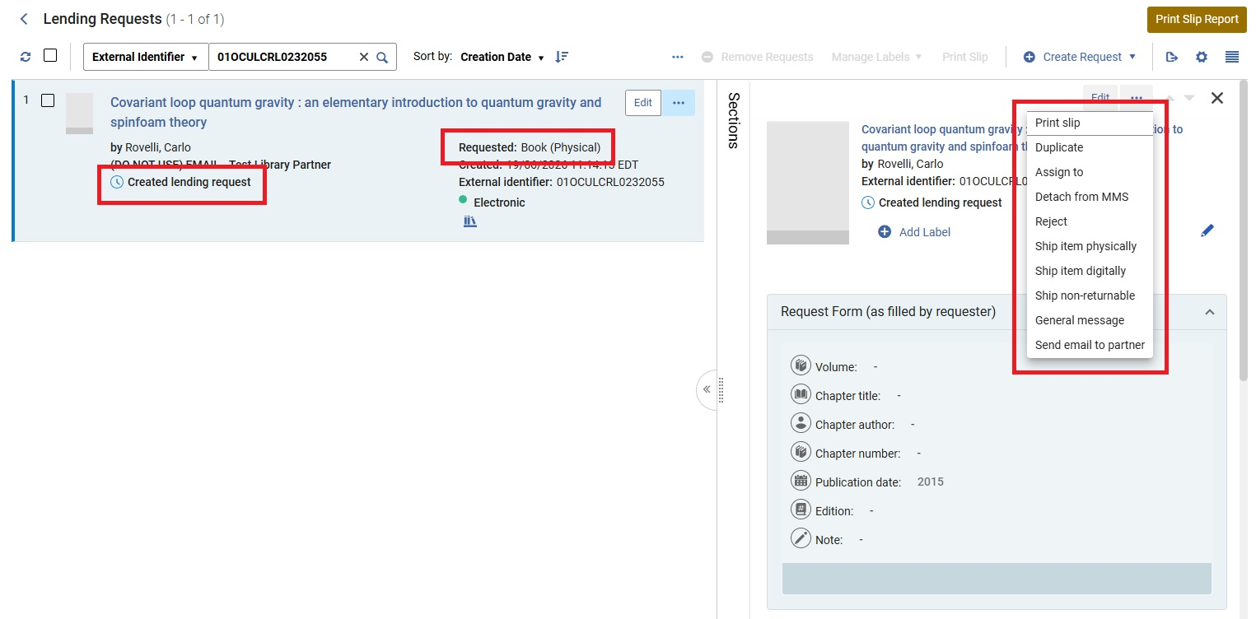
Lending requests screenshots (4)

Slide 21
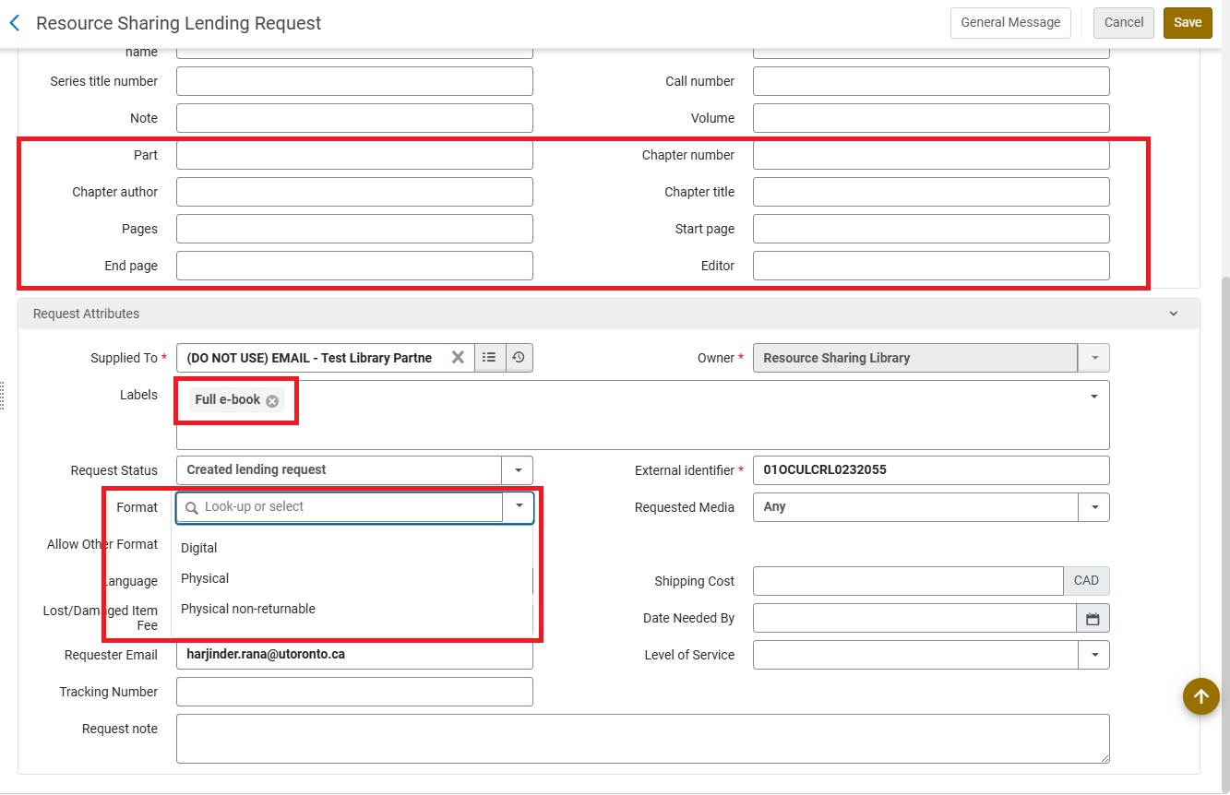
Resource sharing lending request example (2)

Slide 22
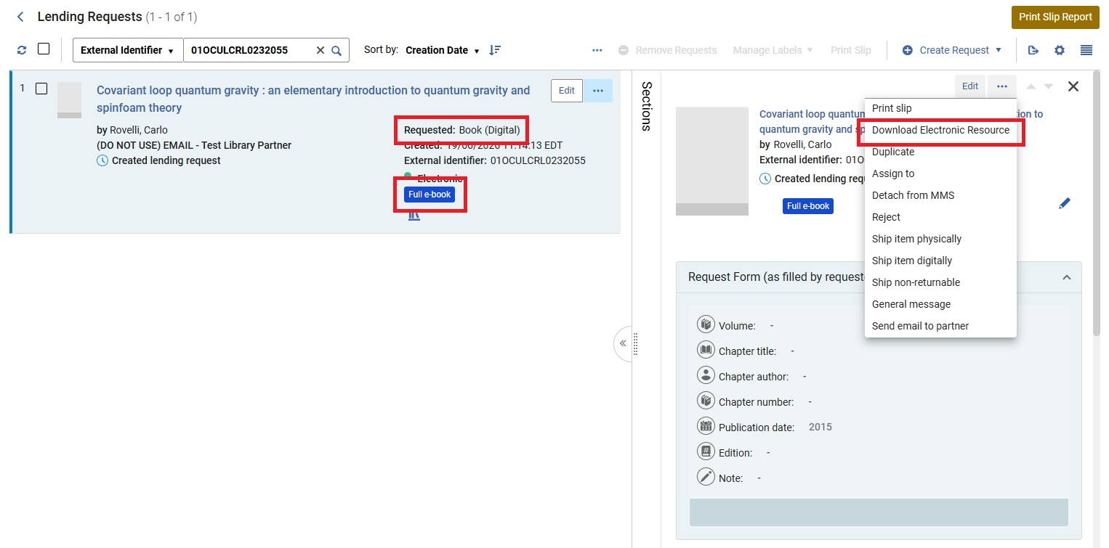
Lending requests screenshots (5)

Slide 23
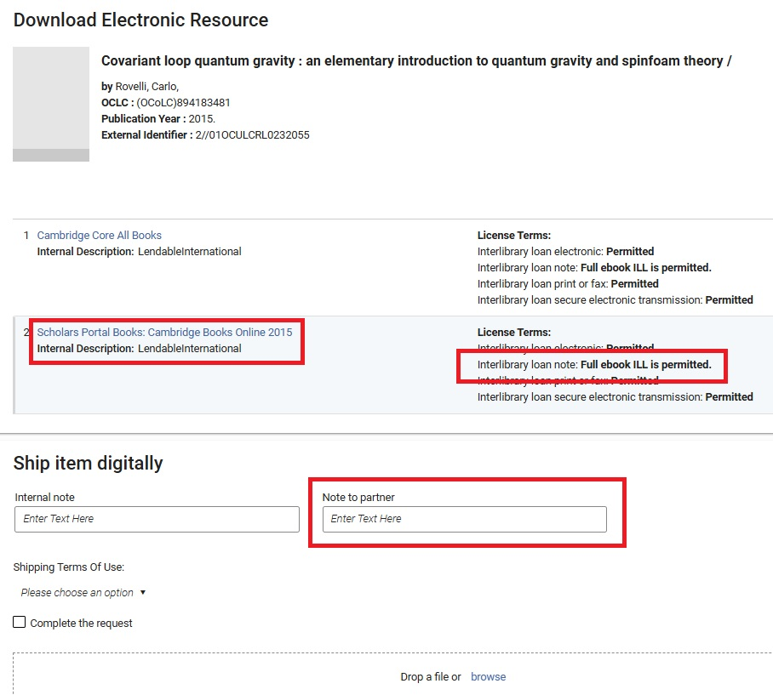
Download e-resource screenshot (2)

Slide 24

Our lending numbers so far
June 4th to July 6th, 2026:
Total e-books loaned via Alma = 48
  Only an e-book copy
  in our collection = 13
  Both e-book and print copies
  in our collection = 35

Slide 25

Challenges
Facilitating requests on the borrowing side
Downloading a full PDF on some vendor platforms
Transmitting large file sizes
Negotiating more licenses and addressing vendor concerns

Slide 26

What's next?
ILL rights part of all future license negotiations
Advocacy and awareness
  The Boston Library Consortium has been a leader in this area
E-book ILL for out of copyright print books at Downsview
  In partnership with the Internet Archive
E-book lending outside Alma Resource Sharing
  OCLC WorldShare, Rapido

Slide 27

The End!

Slide 28
Thank you
Erin Calhoun, Electronic Resources Librarian erin.calhoun@utoronto.ca
Harjinder Rana, Resource Sharing Librarian harjinder.rana@utoronto.ca

