Slide 1
Teamwork Makes the Dream Work: What's Happening with Collaborative Futures
Anika Ervin-Ward - Assistant Director, Collaborative Initiatives
Nicole Morgan - Network Zone Collection Coordinator
Alex Fletcher - Omni Network Zone and Technology Specialist
Notes:
OCUL Collaborative Futures staff:
Anika Ervin-Ward - Assistant Director, Collaborative Initiatives
Nicole Morgan - Network Zone Collection Coordinator
Alex Fletcher - Omni Network Zone and Technology Specialist
Coordinating the shared library services platform = responding to member needs
Our teamwork is about supporting your team(s)

Slide 2
Network Zone Collections

Slide 3
Advancing NZERMWG Recommendations
Implement collection strategy
Expand licenses
Transition maintenance to OCUL office

Slide 4
Work Underway
Knowledge & duties transfer
Record cleanup
Maintenance routines
Cross-team workflows
Strategy development
Next: Member consultations

Slide 5
Member Consultations
Discuss cross-functional use cases for:
Network Zone collections and licenses in Alma and Primo
Info about consortial licenses

Slide 6
Onboarding and Training

Slide 7
Needs Assessment
Onboarding and Training Working Group needs assessment
Key findings:
  Inconsistent onboarding
  Lack of central trusted documentation
  Public and role-based documentation preferred
  Step-by-step and scalable for different user levels

Slide 8
Building the Documentation Hub
Supporting work within Alma and Primo in the OCUL context.
High level intro to Omni and our shared Library Services Platform.
Functional area content.
Policies, best practice, configuration and issue reporting.
Point to existing Ex Libris resource.
Housed in SPOTdocs and open to the public.

Slide 9
The Team
Working Group Members
Courtney Bremer (University of Waterloo)
Kaley Fallis (University of Guelph)
Lisl Schoner-Saunders (Algoma University)
Amber Allen (University of Guelph)
OCUL Staff
Alex Fletcher
Katrina Fortner

Slide 10
Resource Sharing

Slide 11
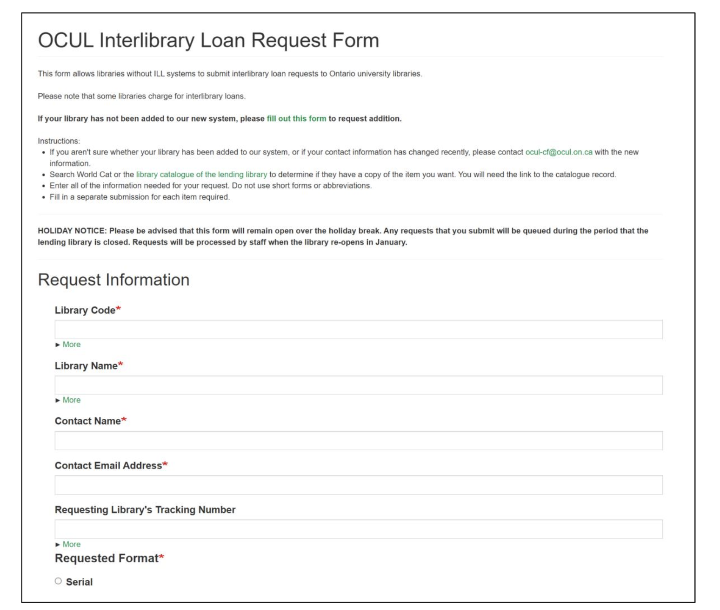
Resource Sharing Form – Then
Release of new ILL form July 10, 2025 (a year ago!)
Work by Michael Walker, OCUL Co-op student

Slide 12
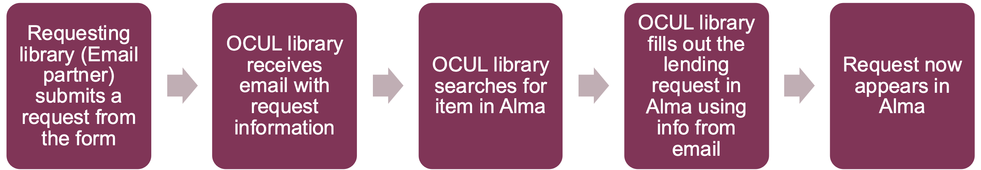
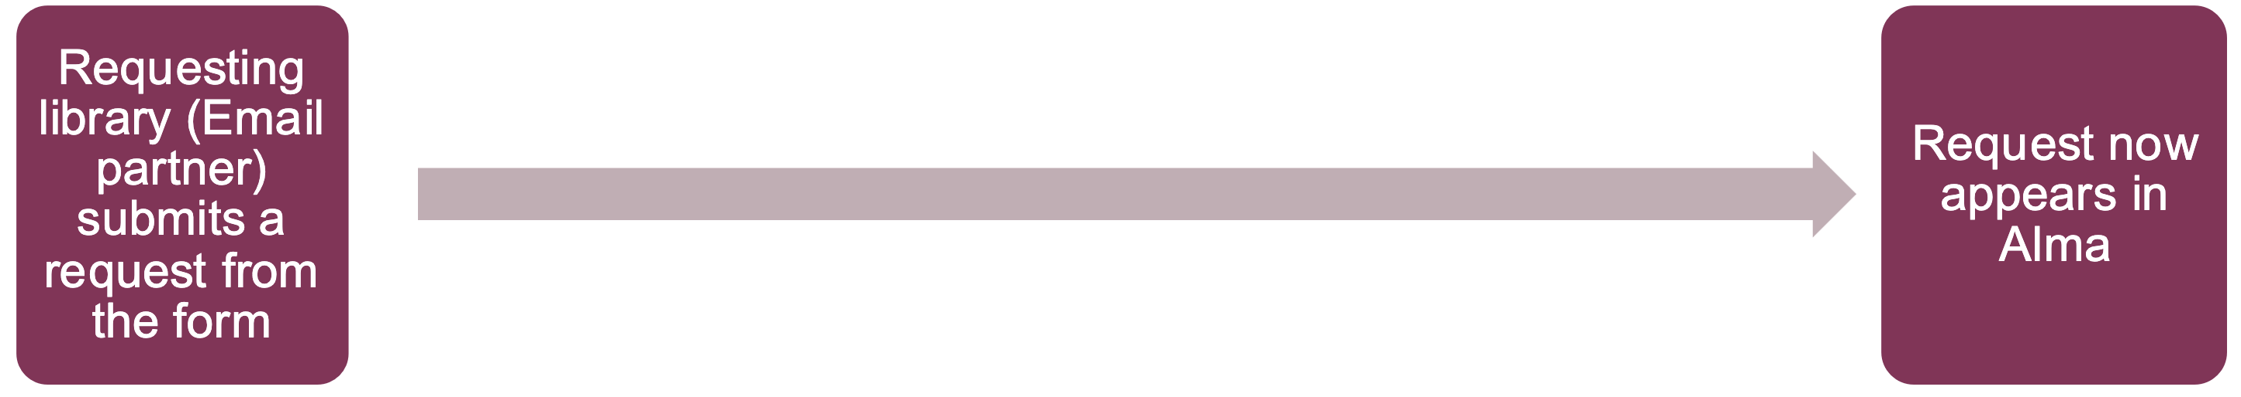
Resource Sharing – The Change
The old email form workflow
The new email form workflow

Slide 13
Resource Sharing – Now
Some numbers:
450 email partners (100 ISO partners, mostly Alma)
4000 request form submissions
  Under 200 via email (120 due to no partner record match)

Slide 14
Thanks!
Sign up for OCUL news and announcements: ocul.on.ca/news-subscription
Follow OCUL on LinkedIn and Bluesky

